Slide 1
Hypertext Preprocessor
PHP

Slide 2
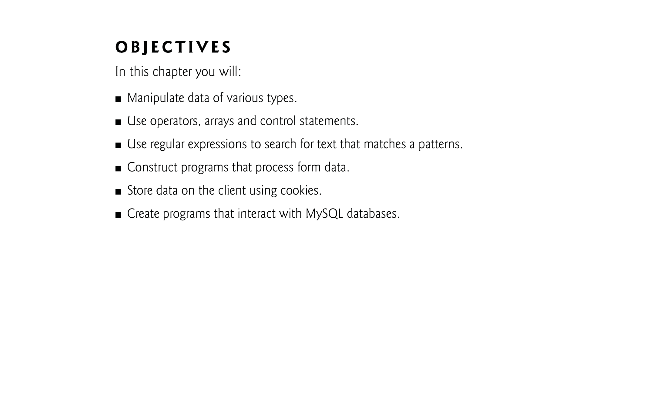

Slide 3
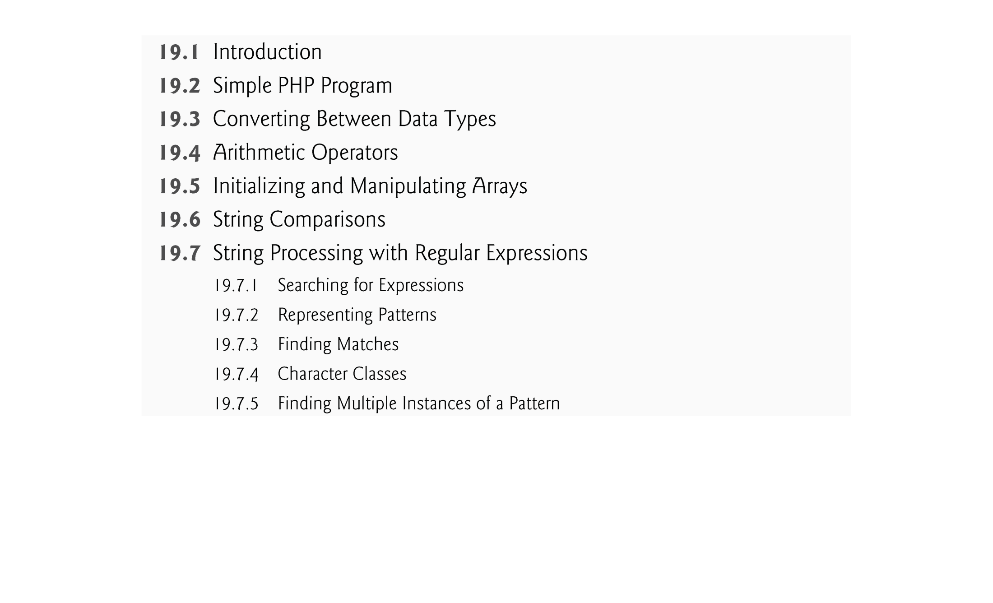

Slide 4
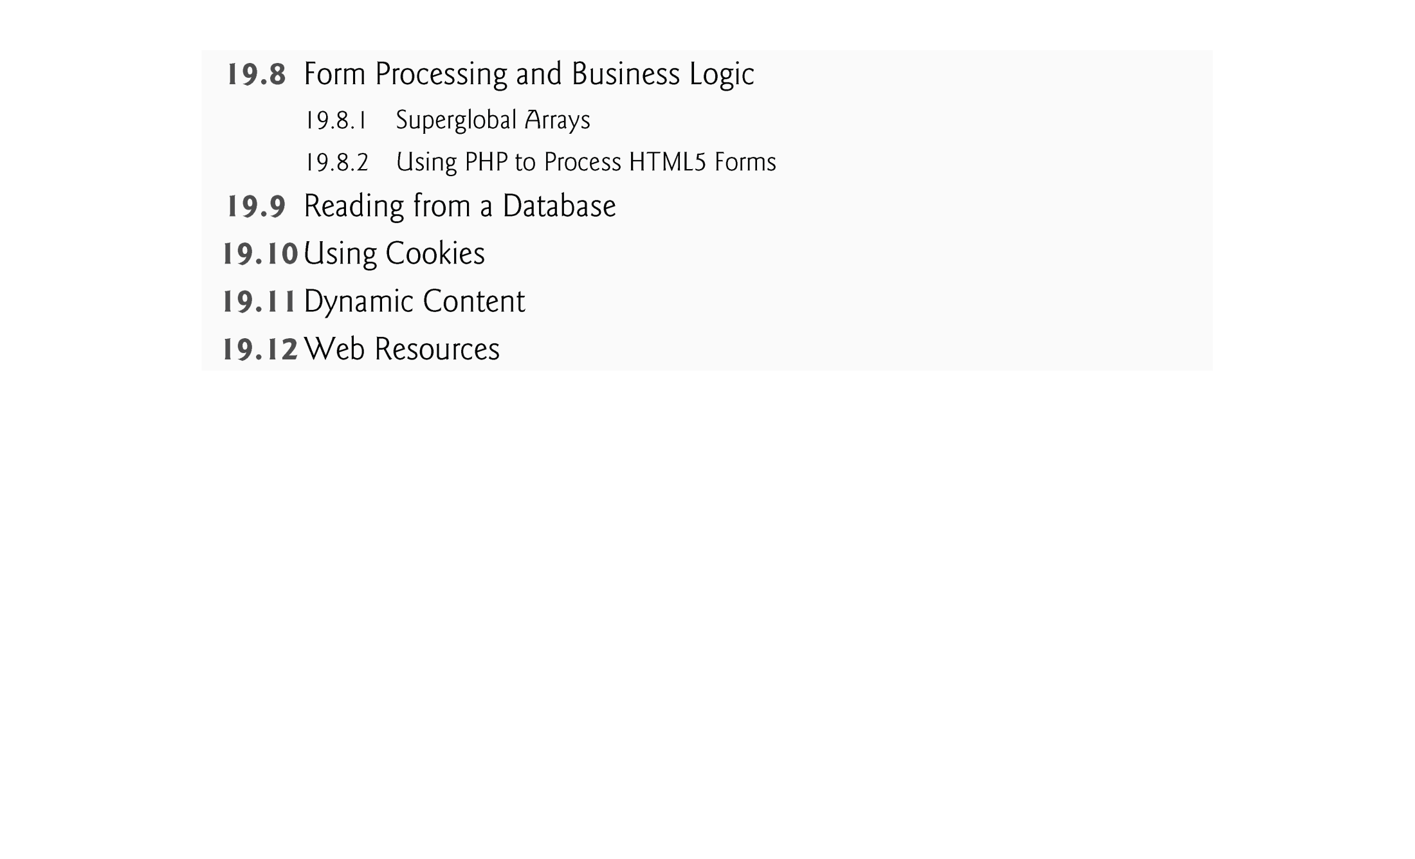

Slide 5
19.1 Introduction
PHP, or PHP: Hypertext Preprocessor, has become the most popular server-side scripting language for creating dynamic web pages.
PHP is open source and platform independent—implementations exist for all major UNIX, Linux, Mac and Windows operating systems. PHP also supports a large number of databases.

Slide 6
19.2 A Simple PHP Program
The power of the web resides not only in serving content to users, but also in responding to requests from users and generating web pages with dynamic content.
PHP code is embedded directly into text-based documents, such as HTML, though these script segments are interpreted by a server before being delivered to the client.
PHP script file names end with .php.
In PHP, code is inserted between the scripting delimiters <?php and ?>. PHP code can be placed anywhere in HTML5 markup, as long as the code is enclosed in these delimiters.

Slide 7
19.2 A Simple PHP Program (Cont.)
Variables are preceded by a $ and are created the first time they’re encountered.
PHP statements terminate with a semicolon (;).
Single-line comments which begin with two forward slashes (//) or a pound sign (#). Text to the right of the delimiter is ignored by the interpreter. Multiline comments begin with delimiter /* and end with delimiter */.
When a variable is encountered inside a double-quoted ("") string, PHP interpolates the variable. In other words, PHP inserts the variable’s value where the variable name appears in the string.
All operations requiring PHP interpolation execute on the server before the HTML5 document is sent to the client.
PHP variables are loosely typed—they can contain different types of data at different times.

Slide 8
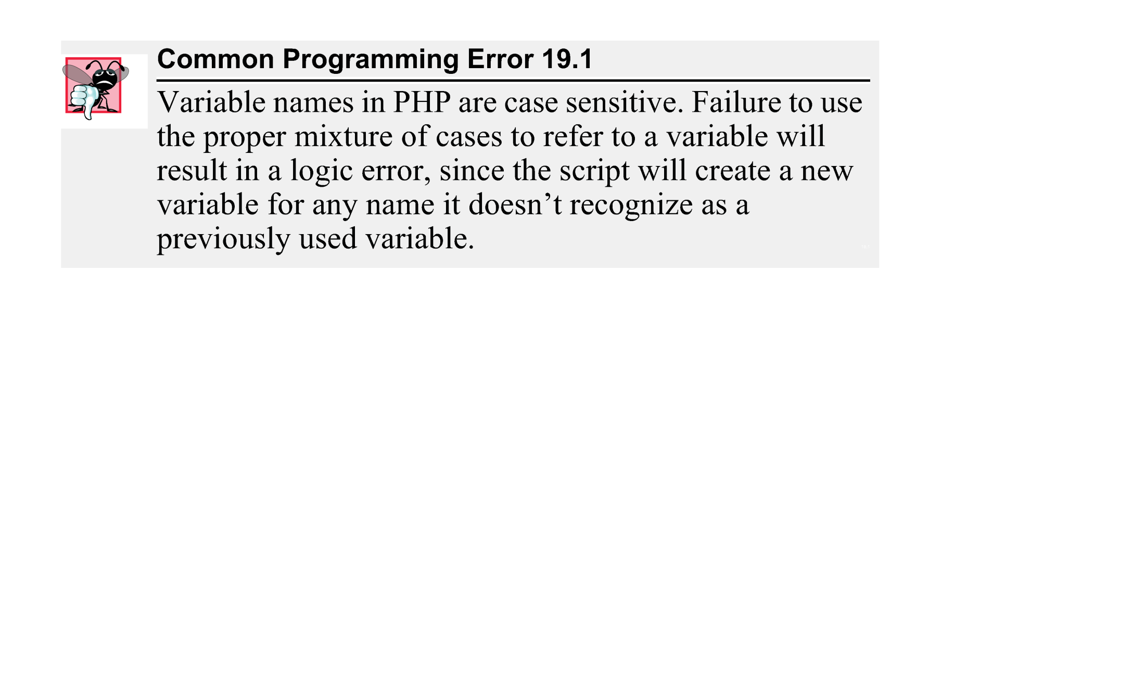

Slide 9
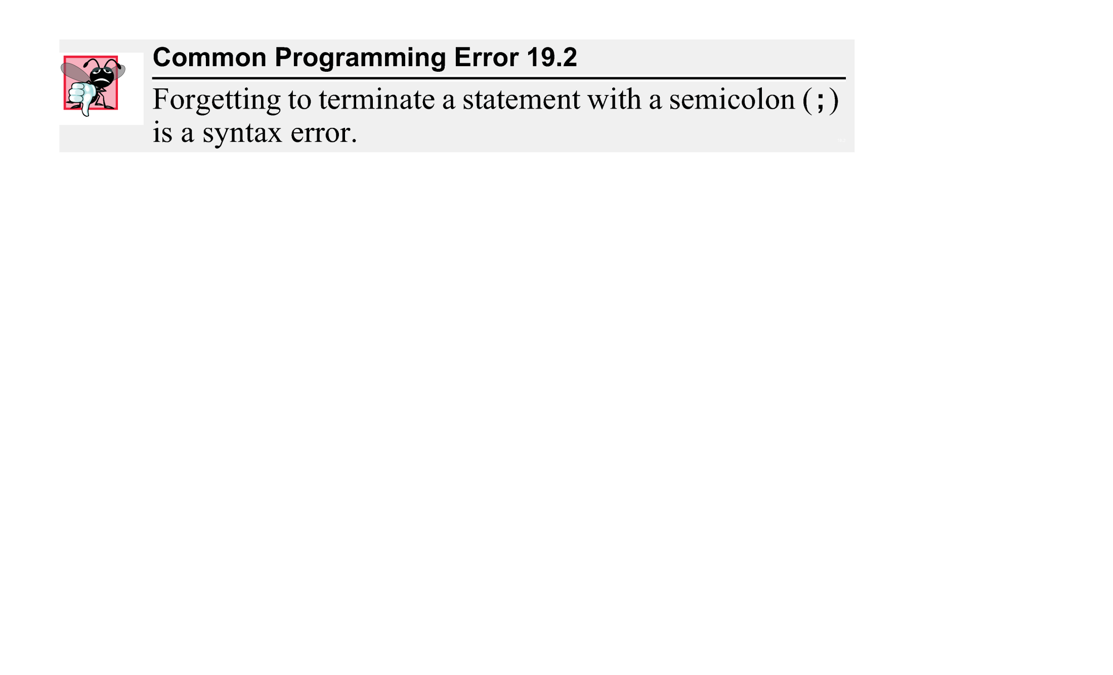

Slide 10
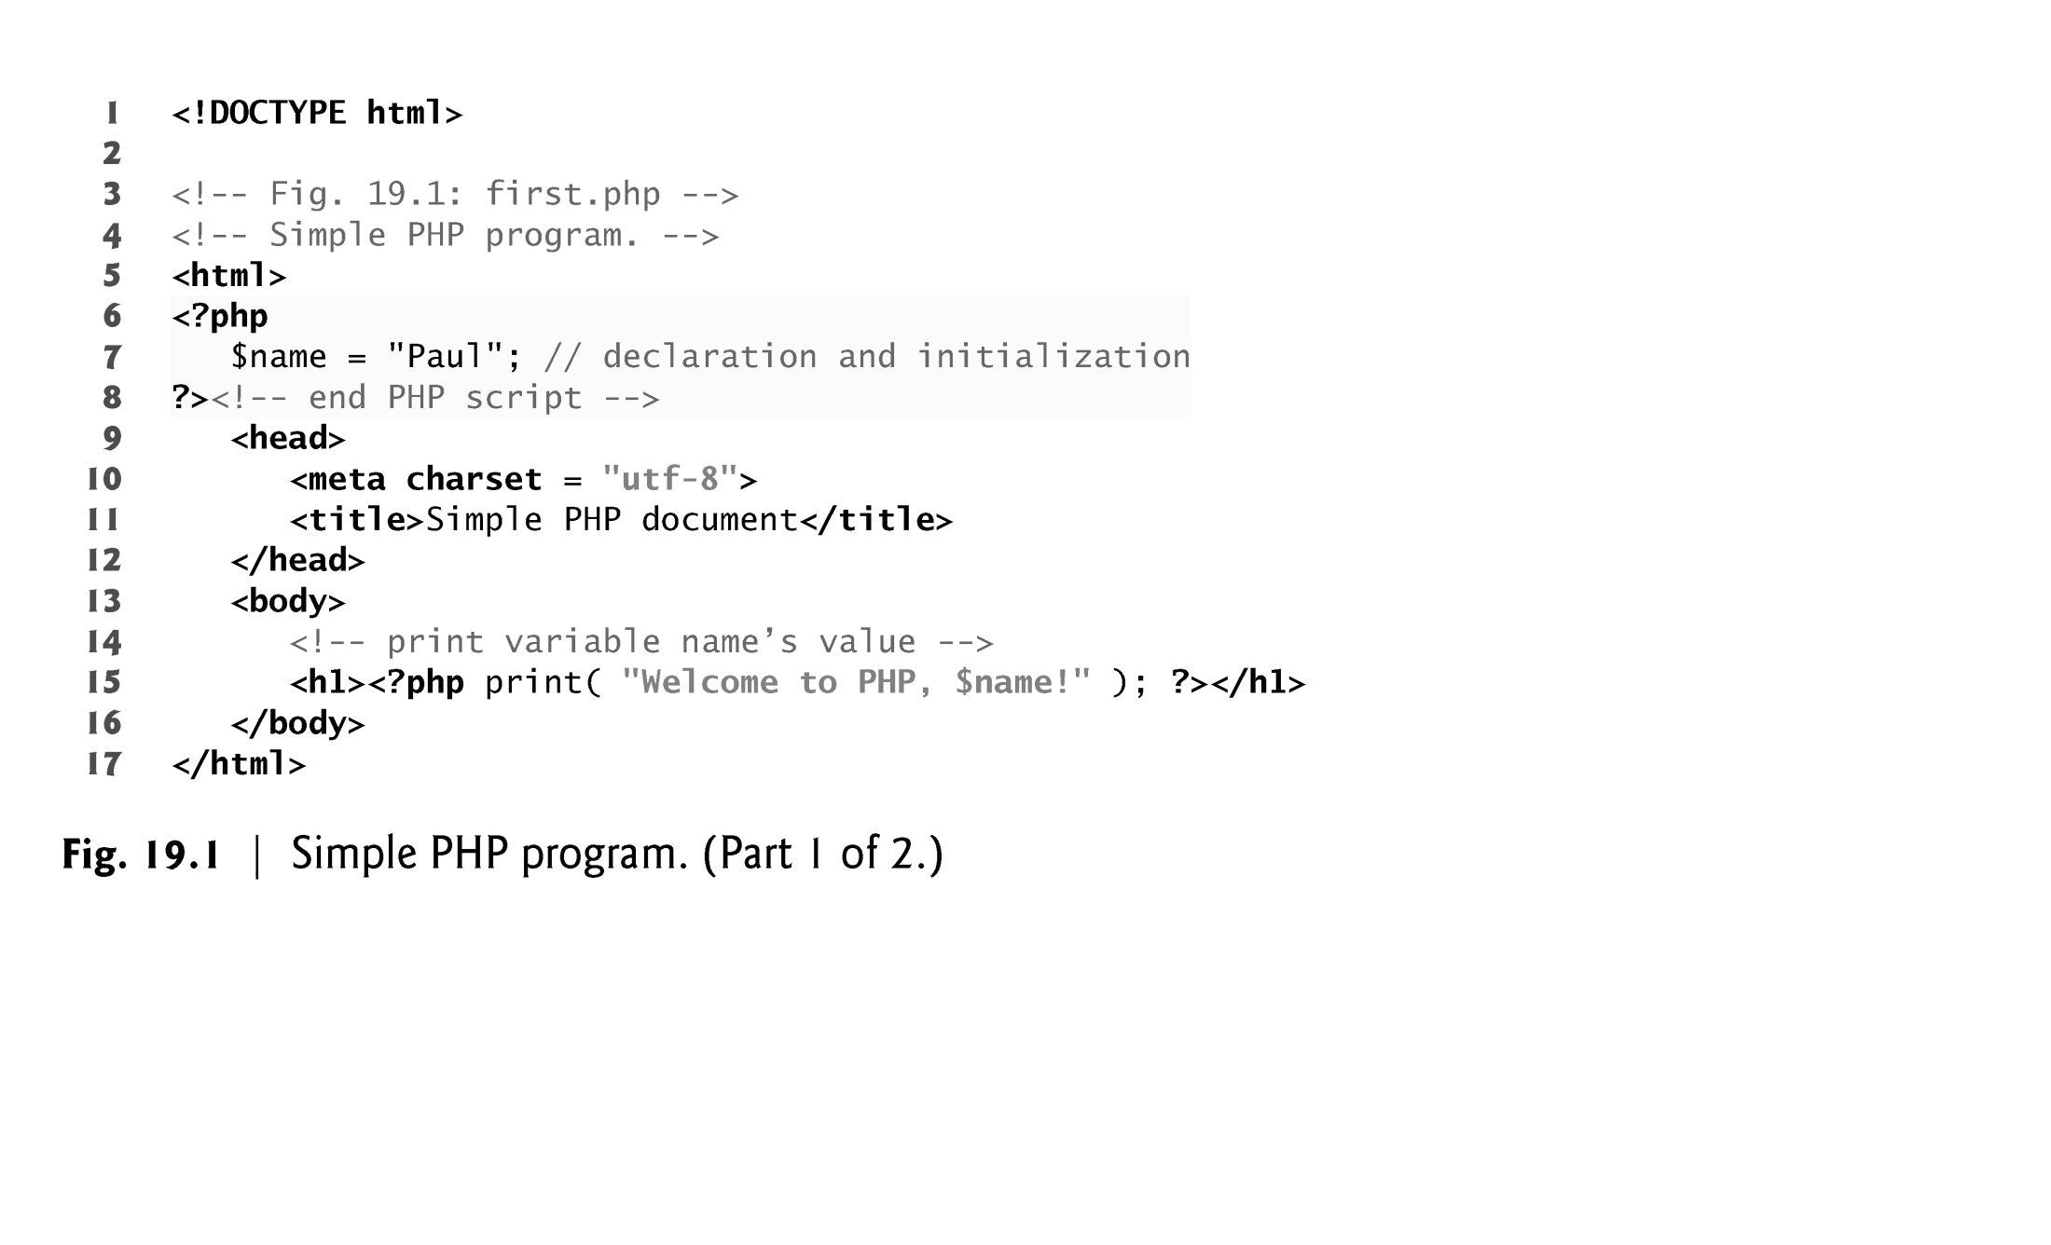

Slide 11
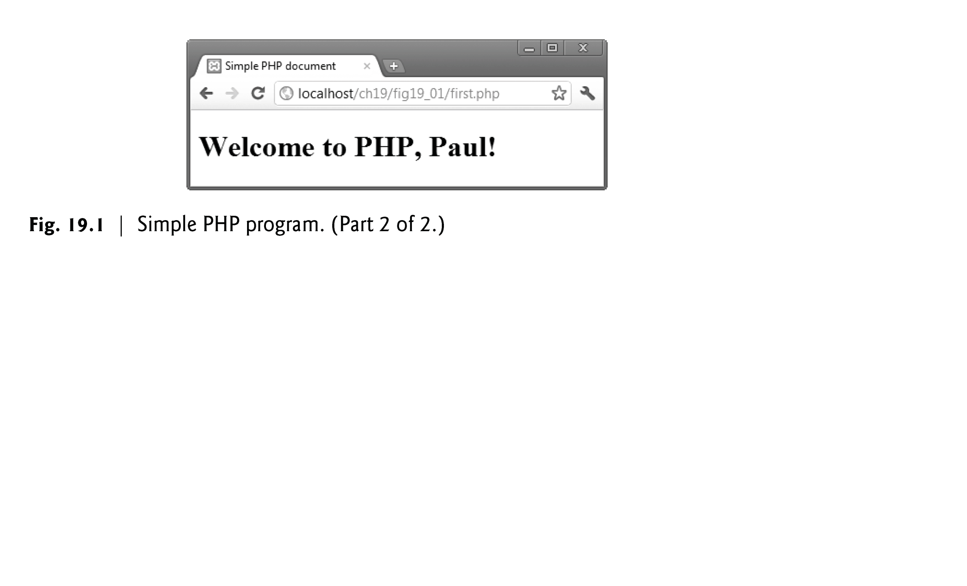

Slide 12
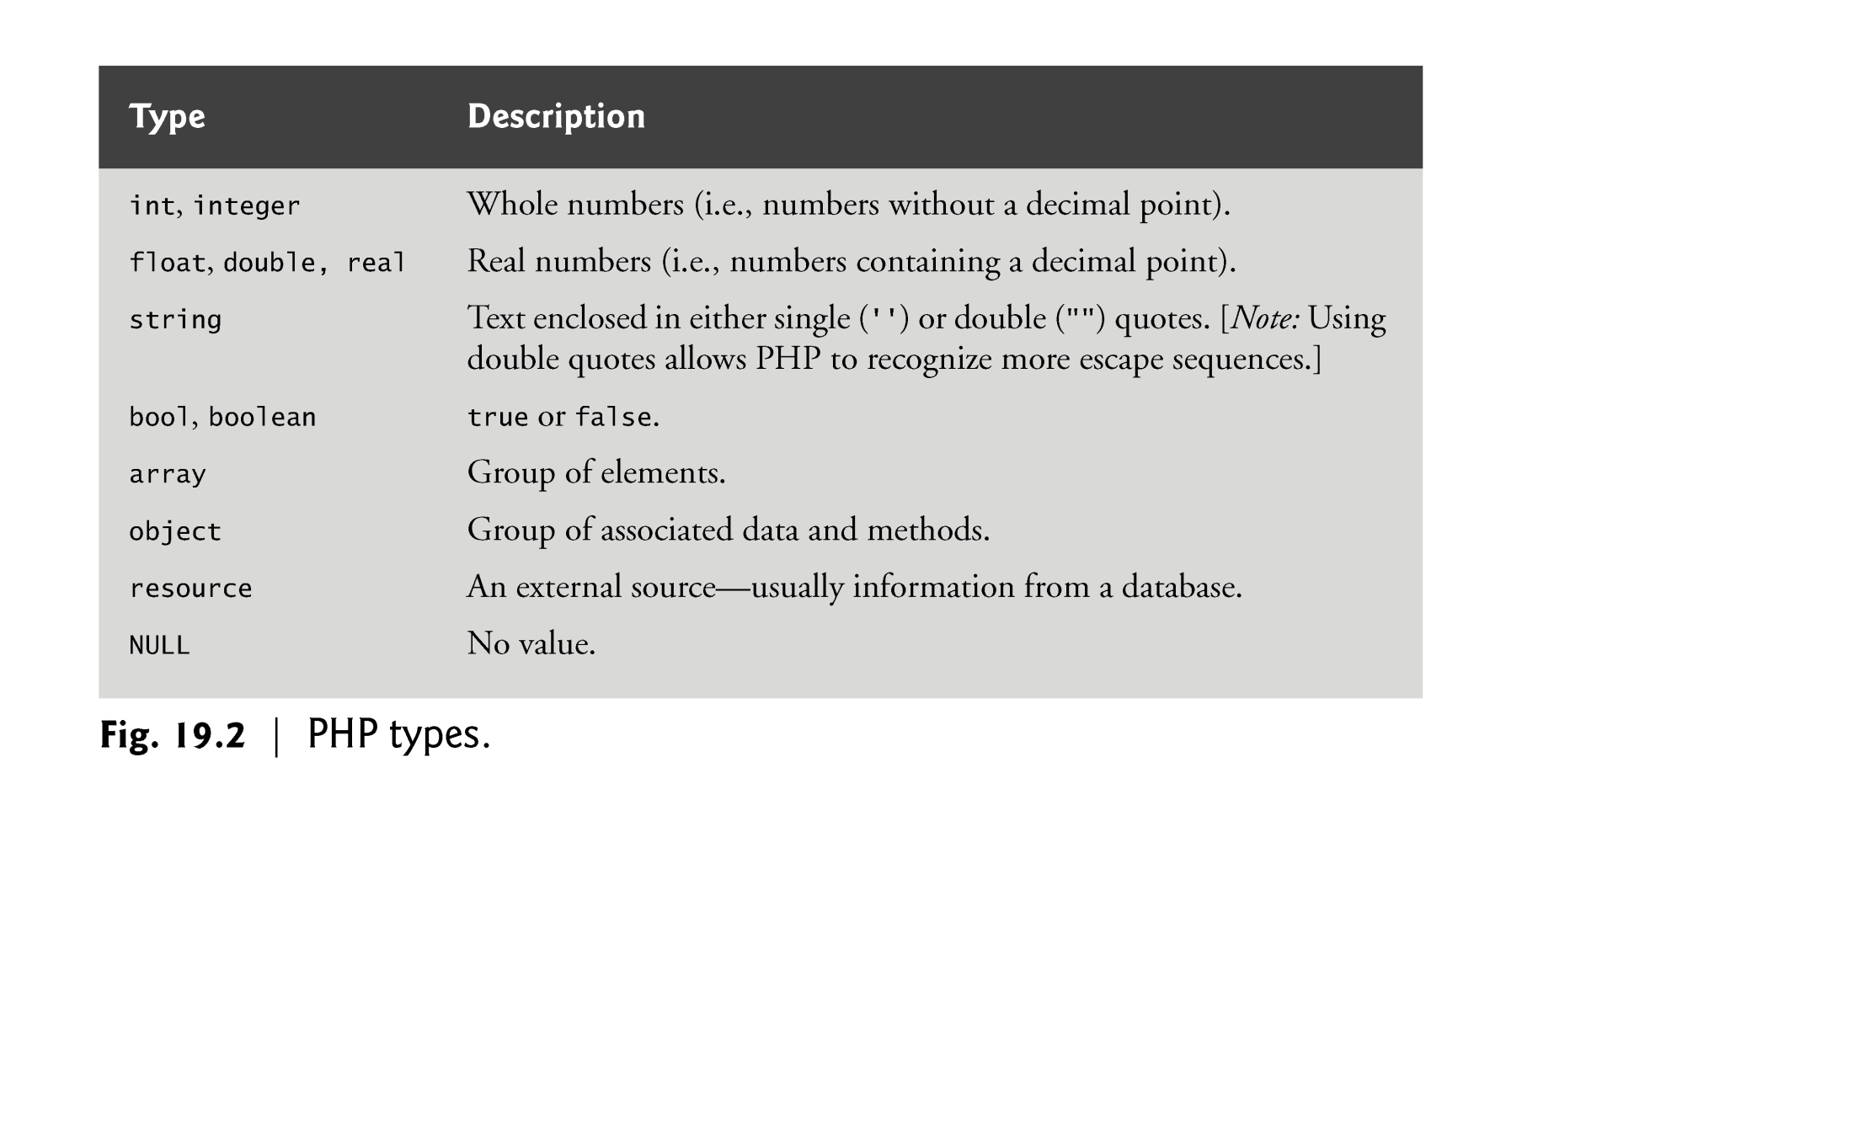

Slide 13
19.3 Converting Between Data Types
Type conversions can be performed using function settype. This function takes two arguments—a variable whose type is to be changed and the variable’s new type.
Variables are typed based on the values assigned to them.
Function gettype returns the current type of its argument.
Calling function settype can result in loss of data. For example, doubles are truncated when they are converted to integers.
When converting from a string to a number, PHP uses the value of the number that appears at the beginning of the string. If no number appears at the beginning, the string evaluates to 0.

Slide 14
19.3 Converting Between Data Types
Another option for conversion between types is casting (or type casting). Casting does not change a variable’s content—it creates a temporary copy of a variable’s value in memory.
The concatenation operator (.) combines multiple strings.
A print statement split over multiple lines prints all the data that is enclosed in its parentheses.

Slide 15
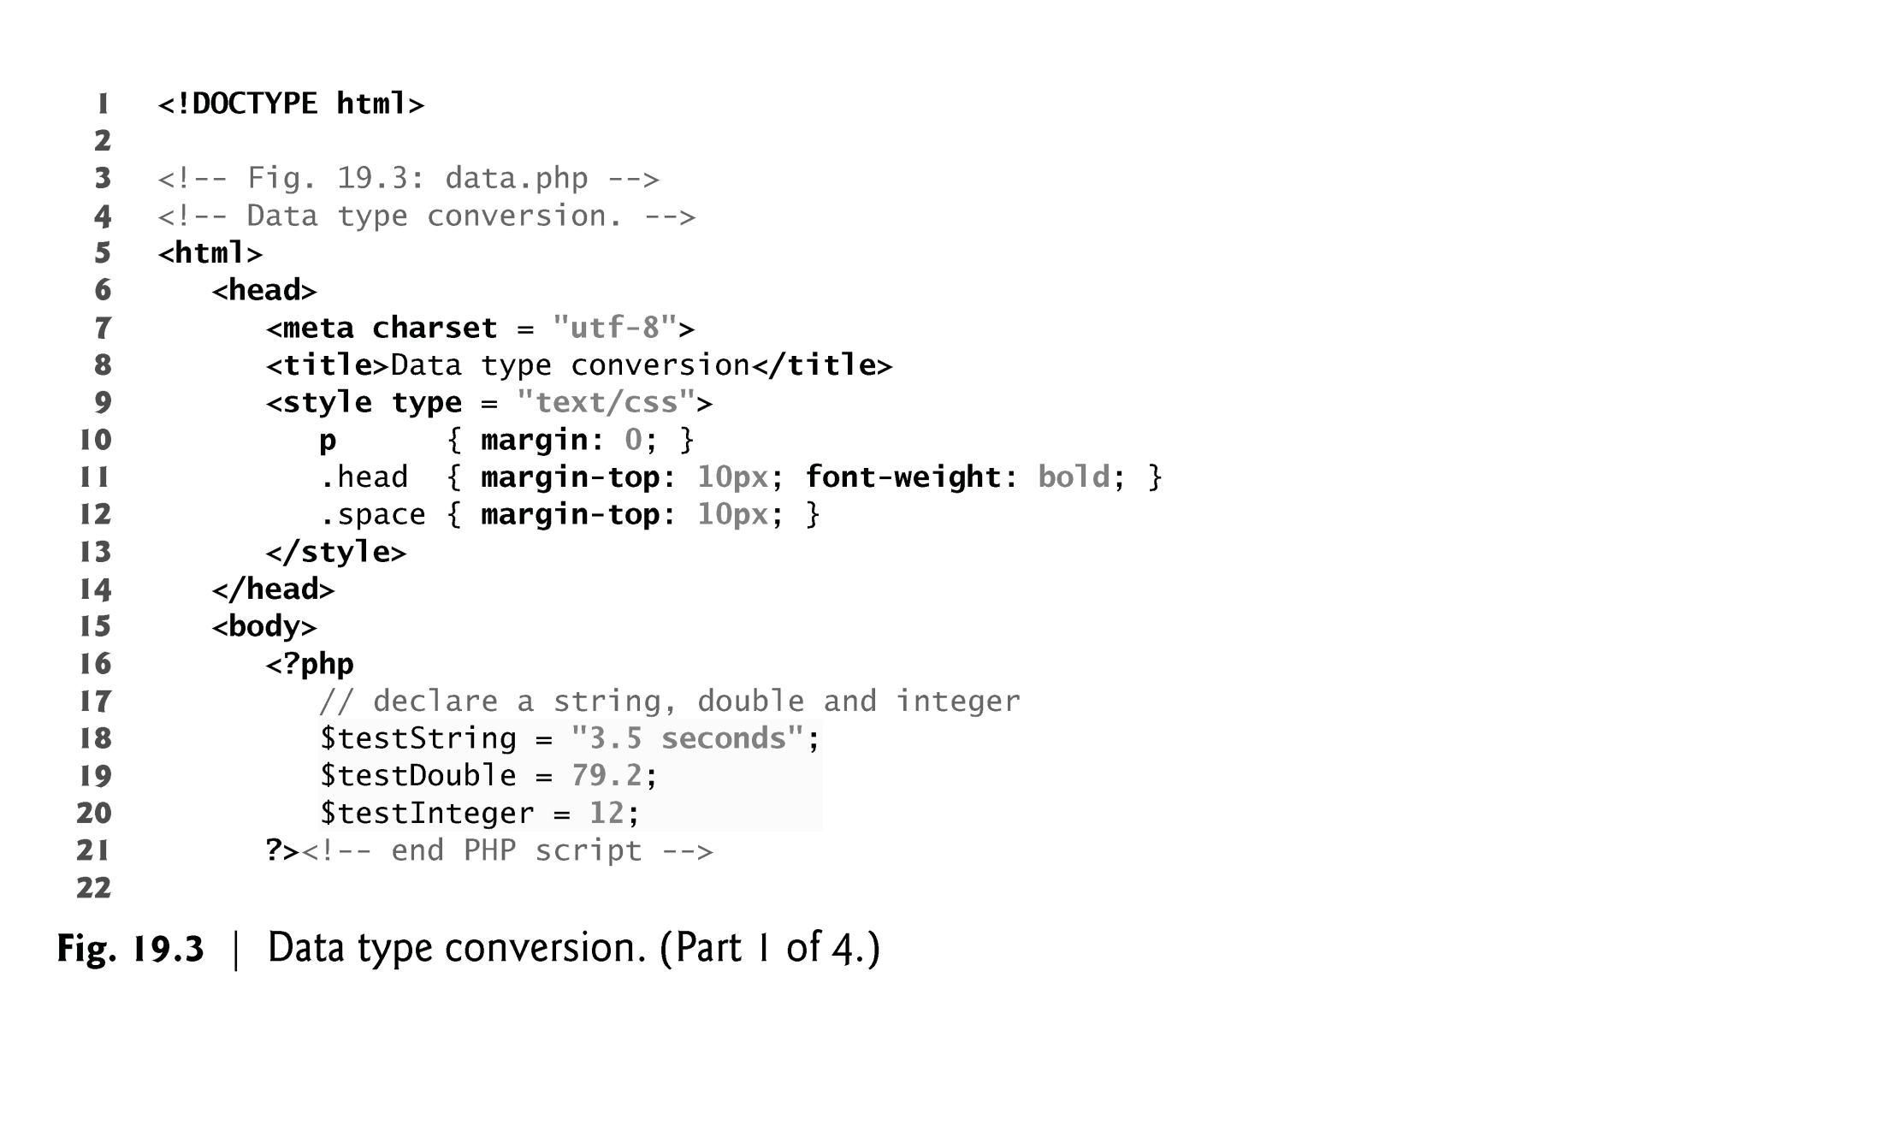

Slide 16
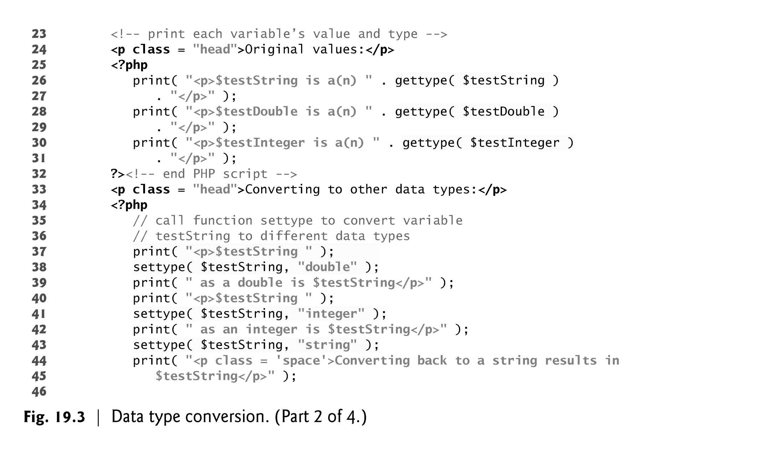

Slide 17
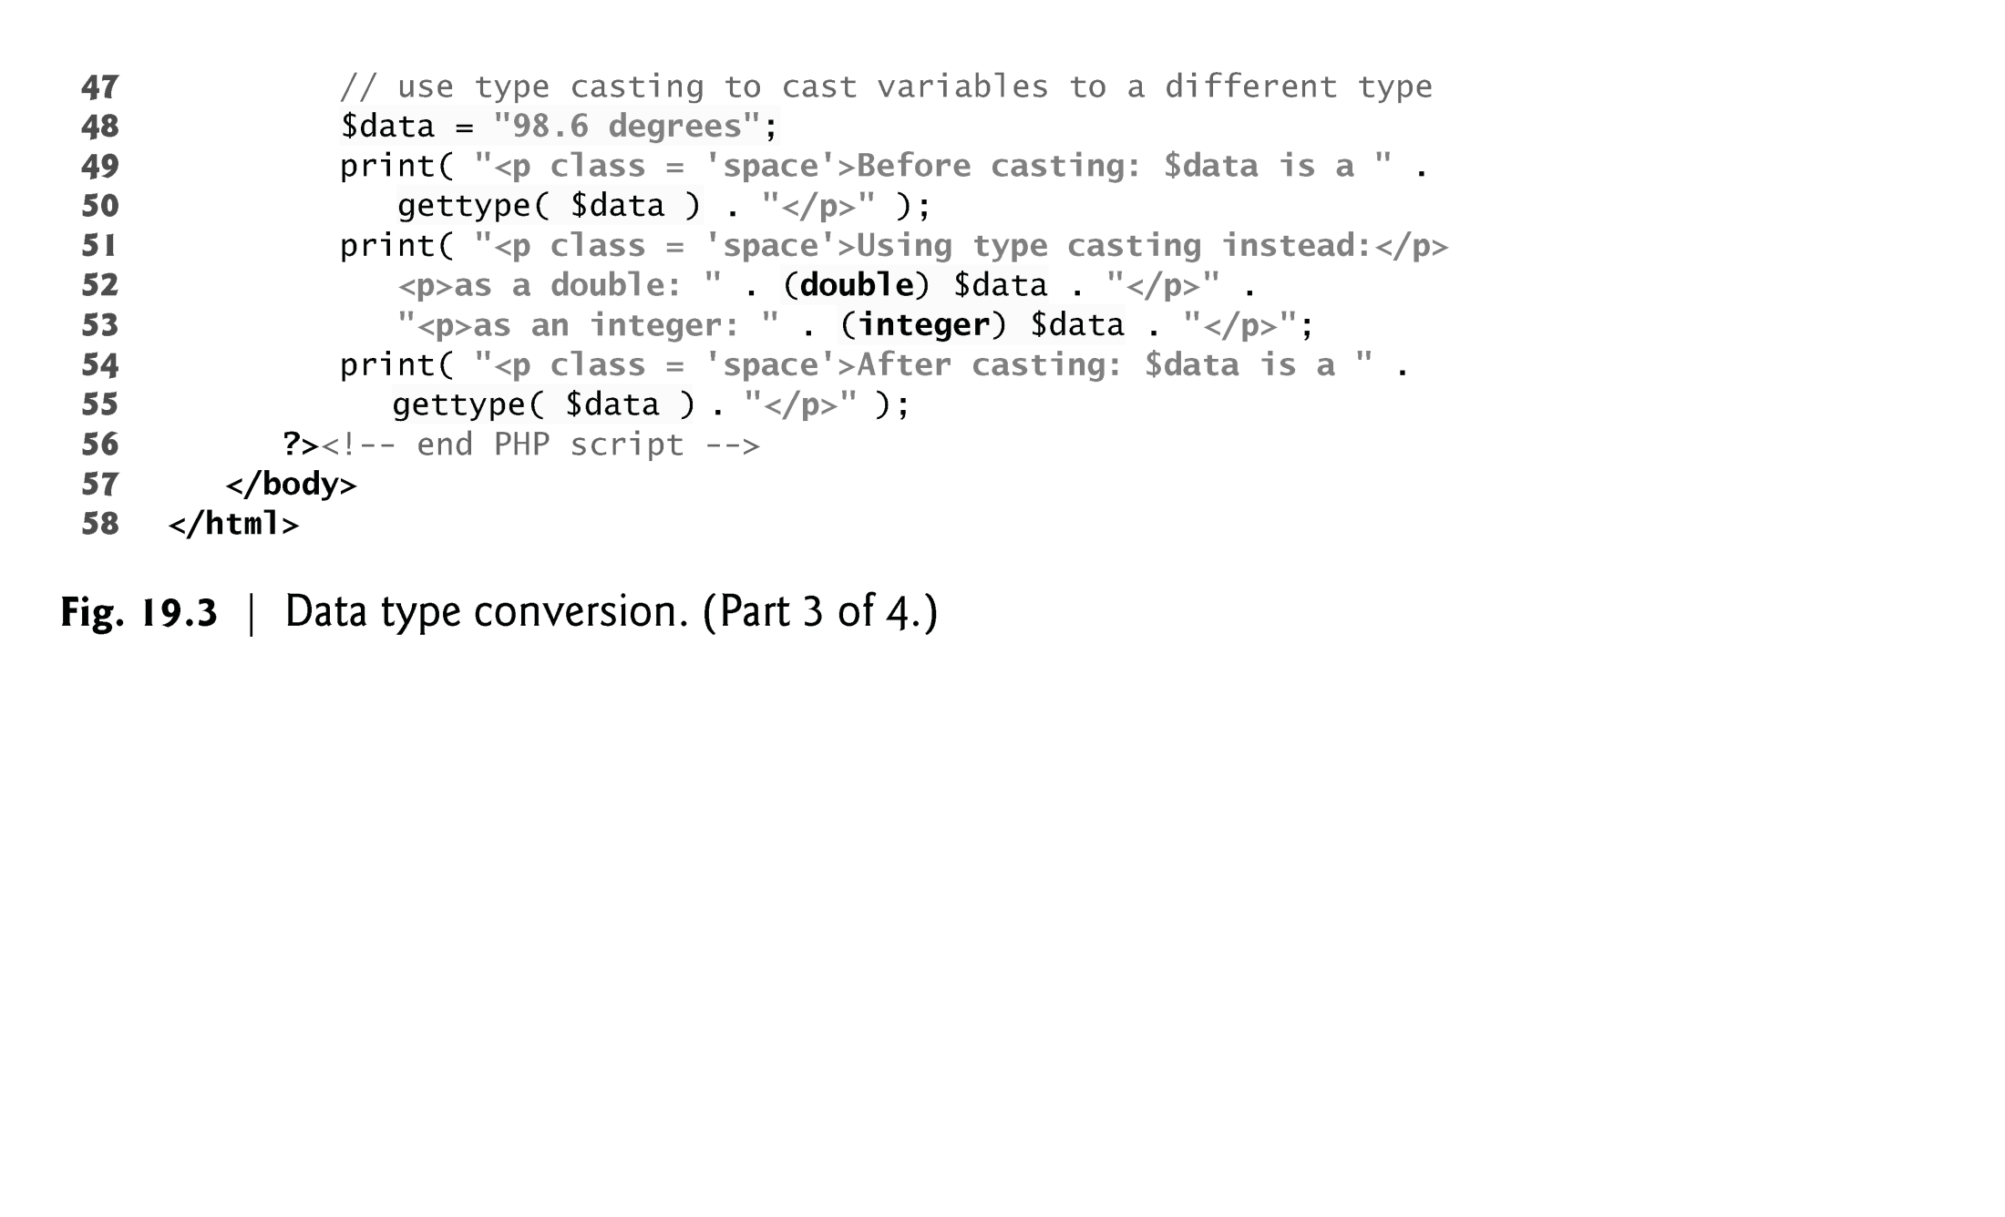

Slide 18
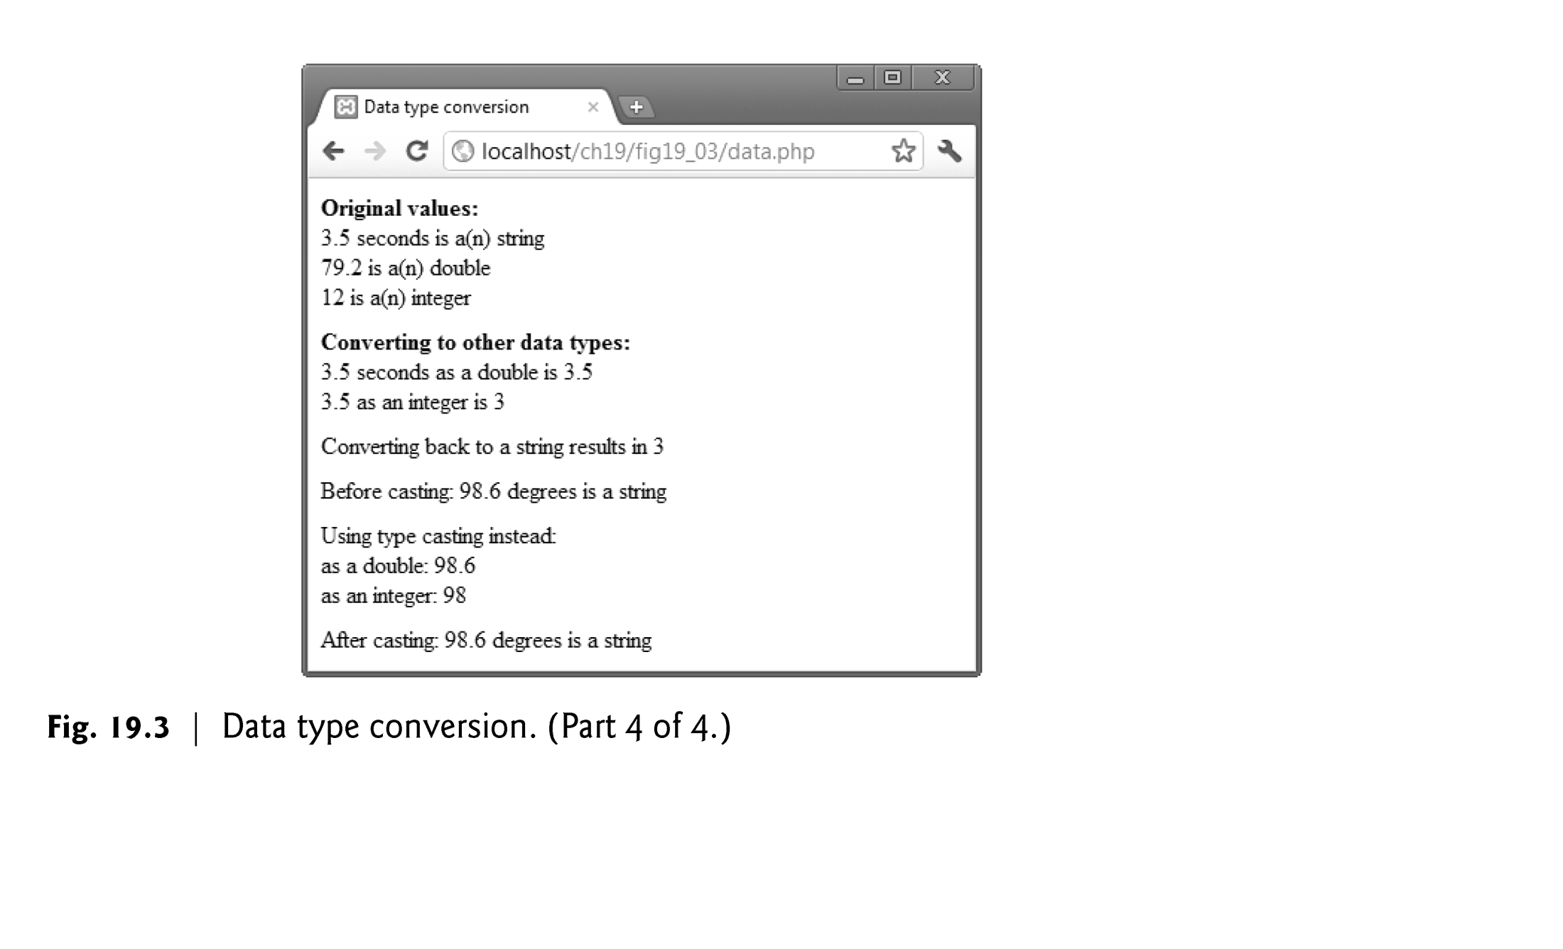

Slide 19
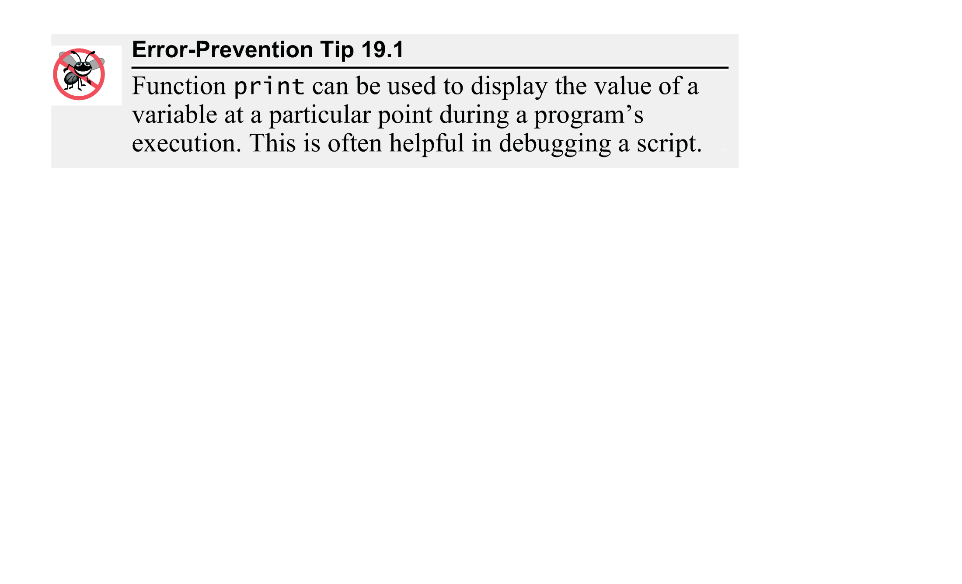

Slide 20
19.4 Arithmetic Operators
Function define creates a named constant. It takes two arguments—the name and value of the constant. An optional third argument accepts a boolean value that specifies whether the constant is case insensitive—constants are case sensitive by default.
Uninitialized variables have undefined values that evaluate differently, depending on the context. In a numeric context, it evaluates to 0. In contrast, when an undefined value is interpreted in a string context (e.g., $nothing), it evaluates to the string "undef".
Keywords may not be used as function, method, class or namespace names.

Slide 21
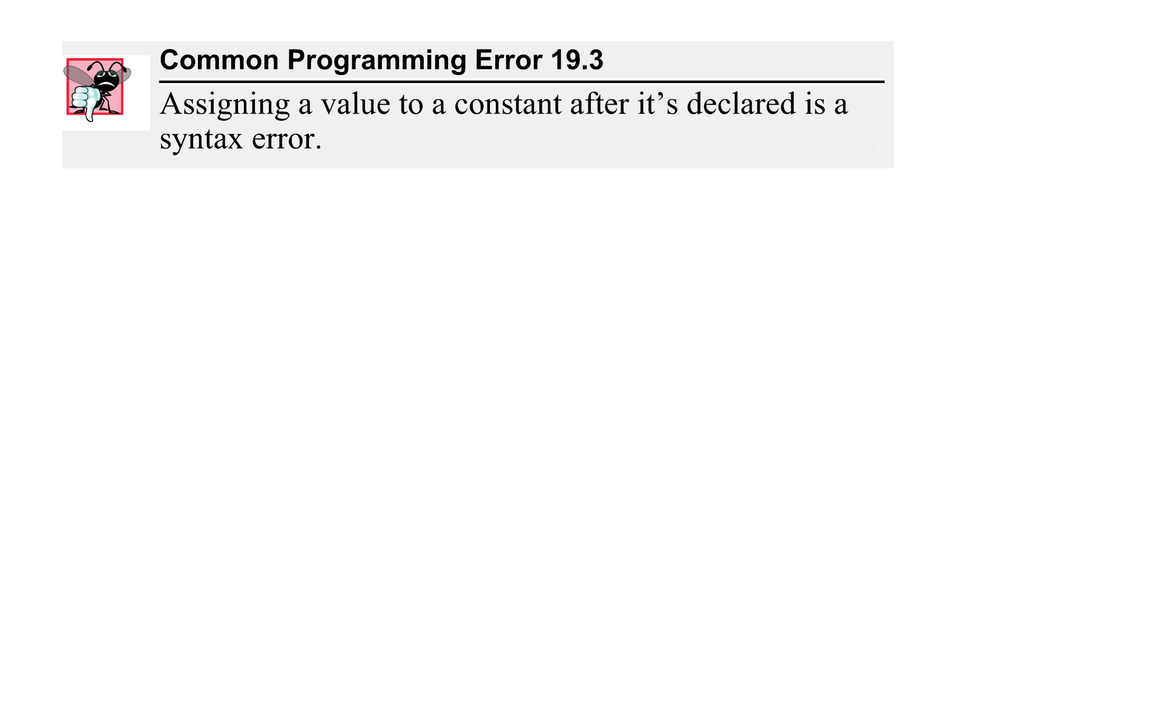

Slide 22
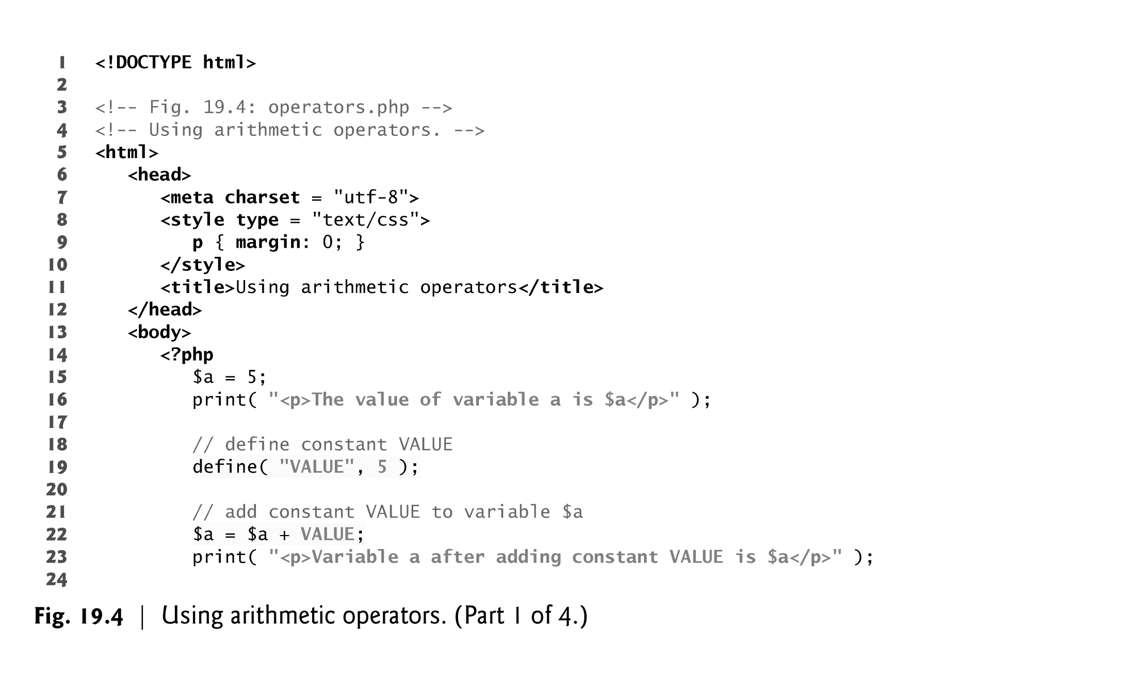

Slide 23
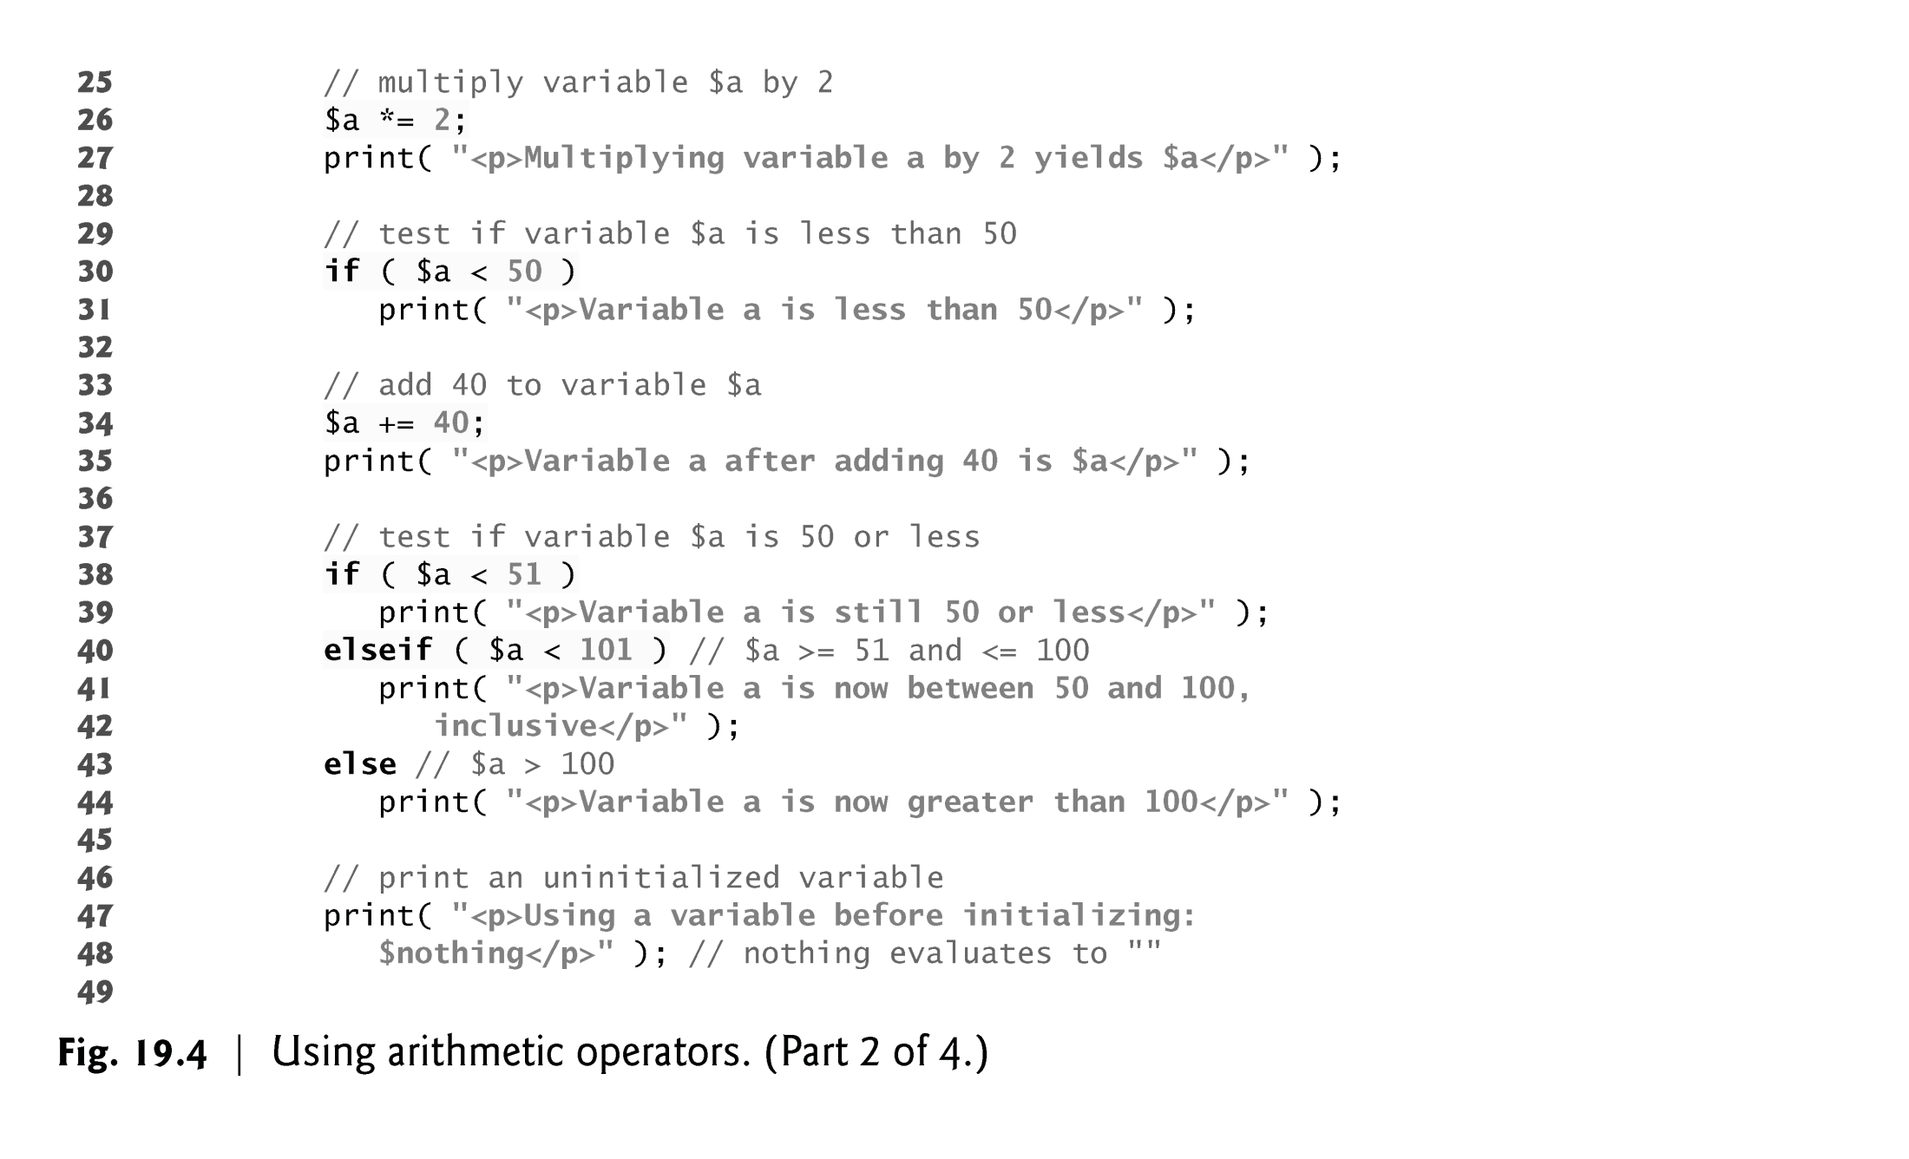

Slide 24
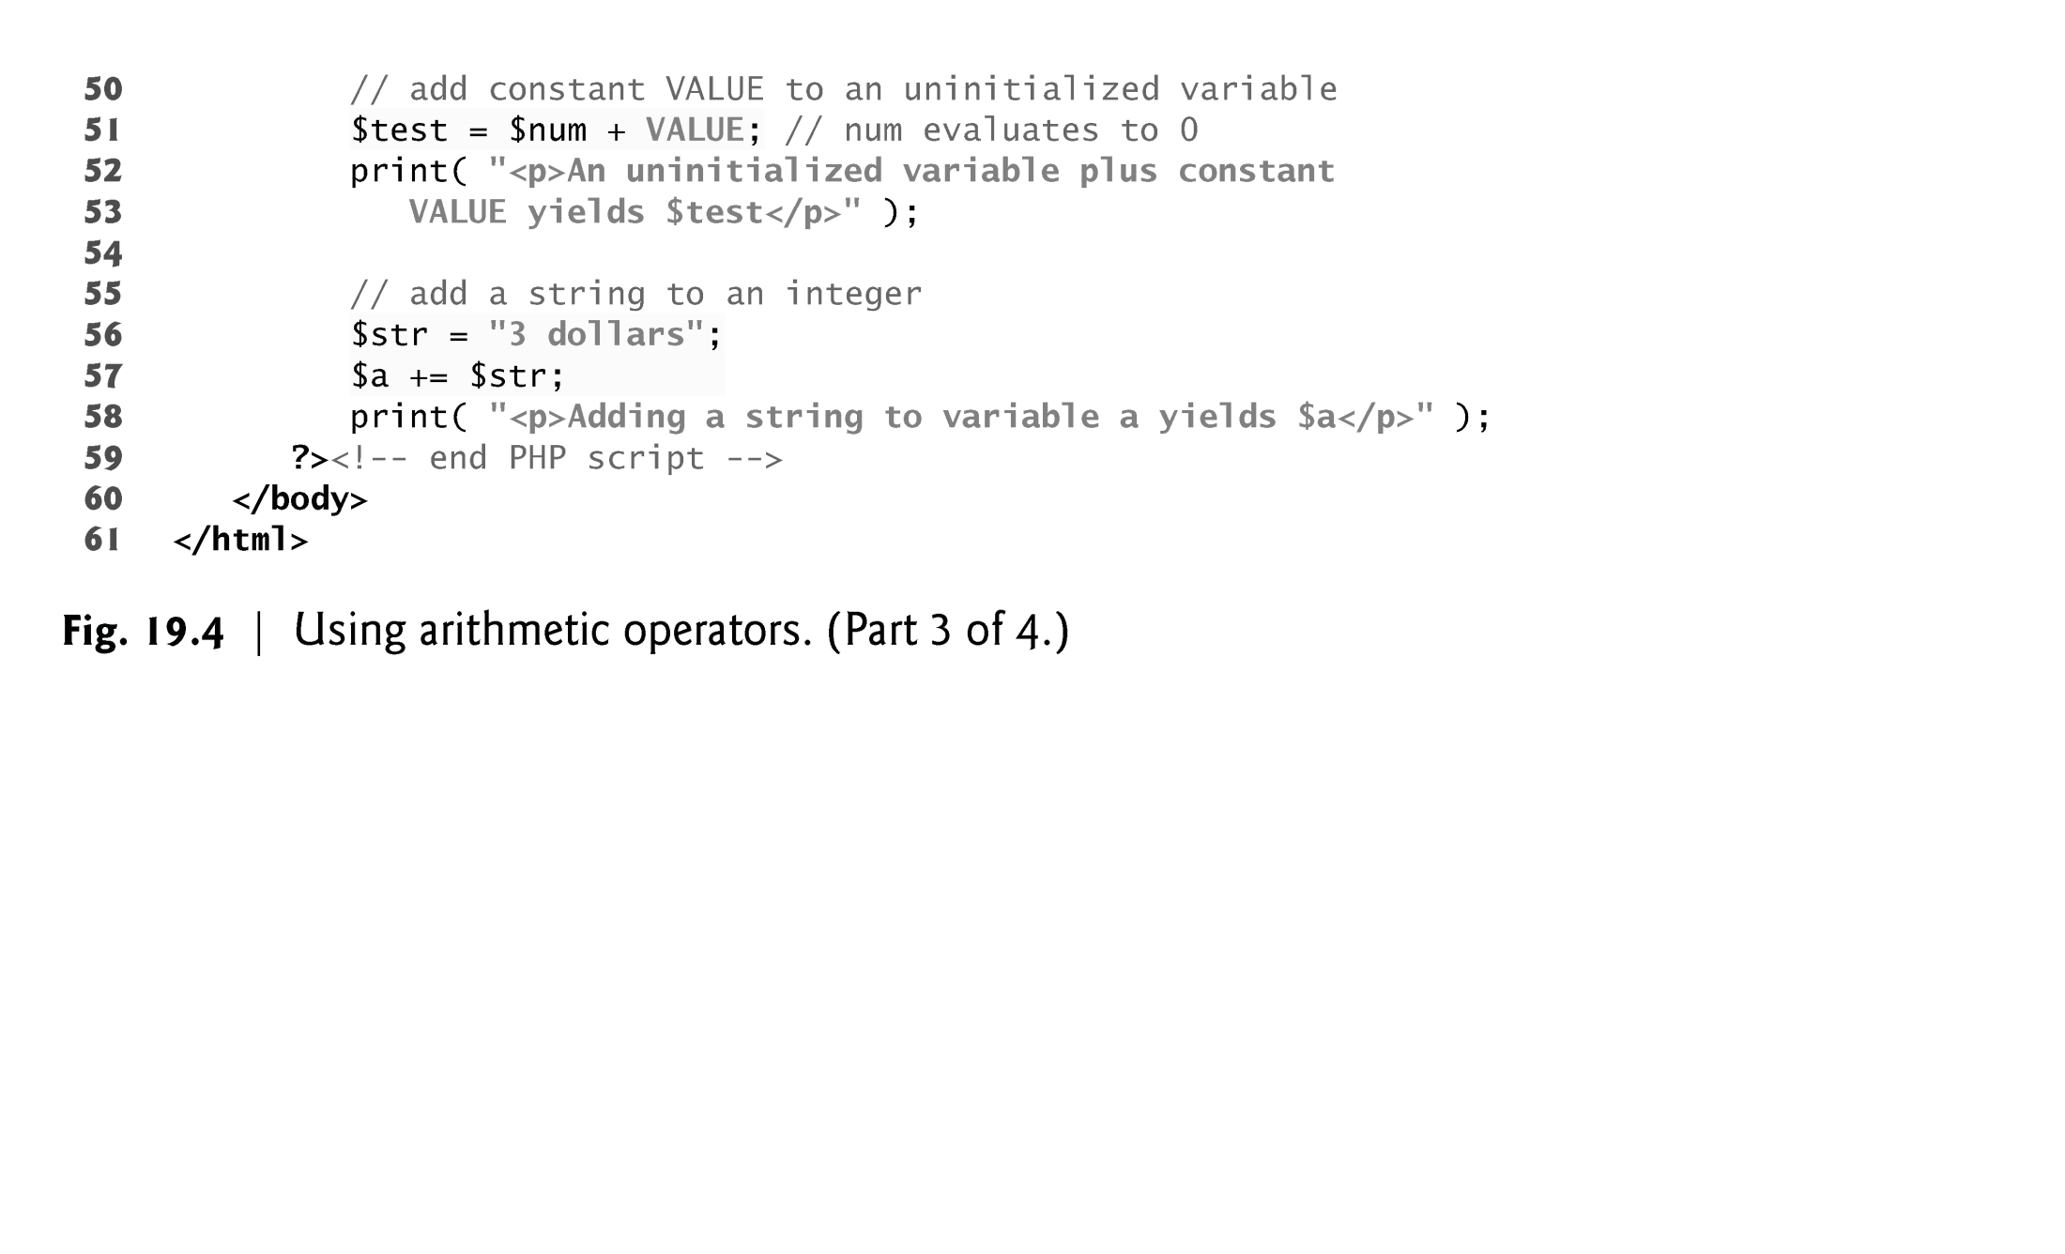

Slide 25
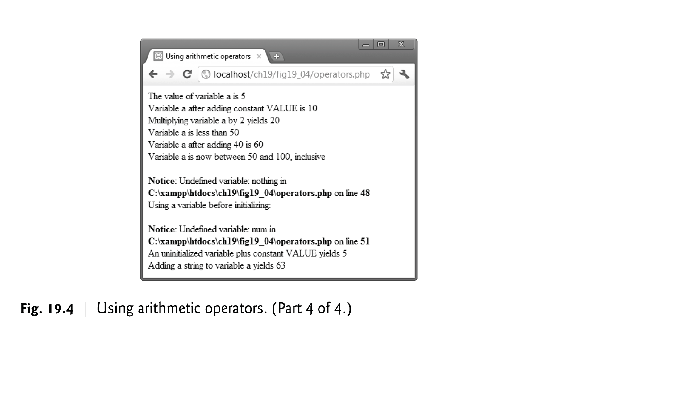

Slide 26
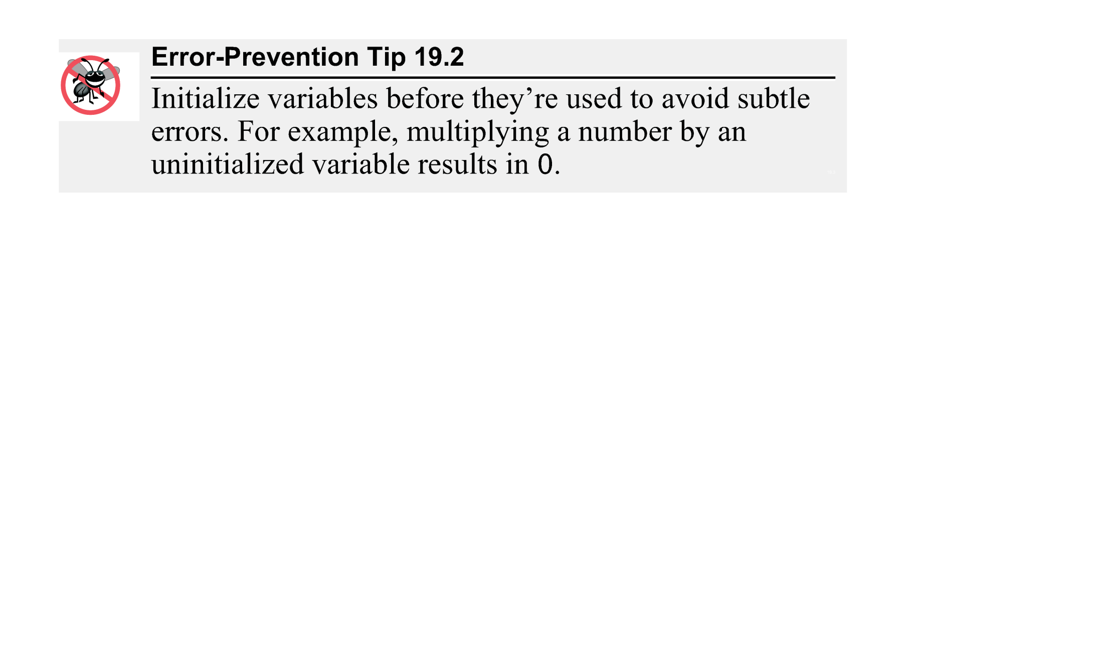

Slide 27
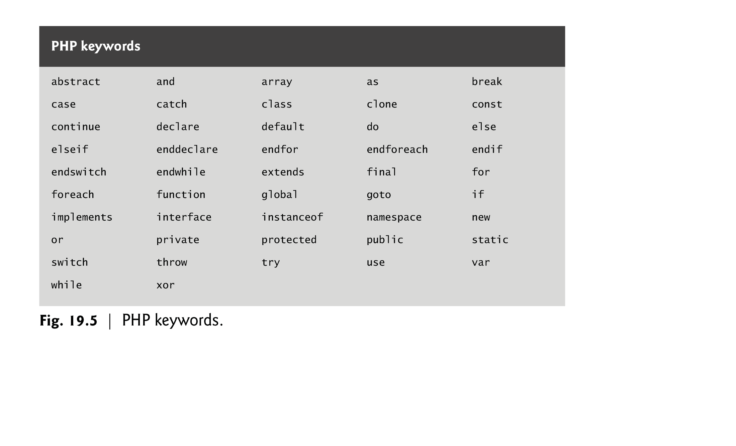

Slide 28
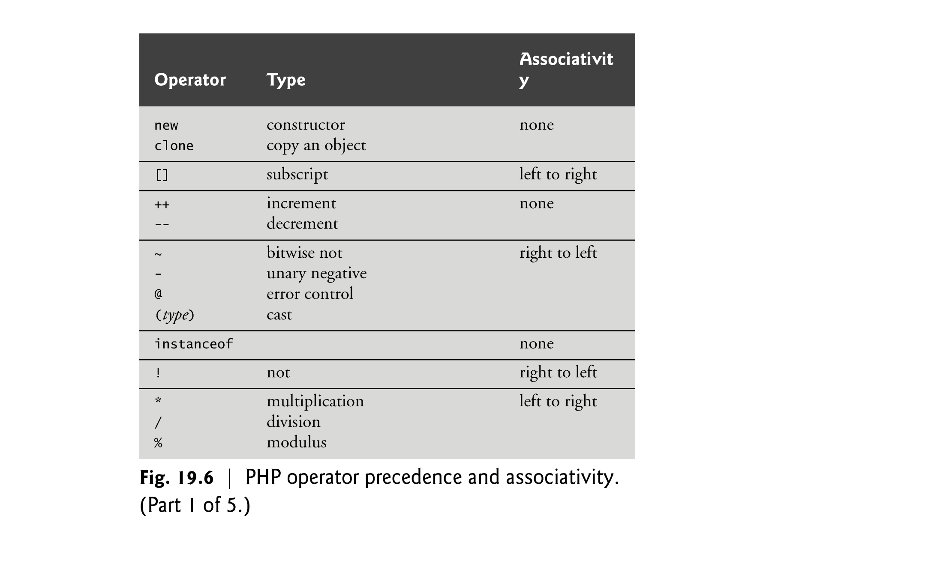

Slide 29
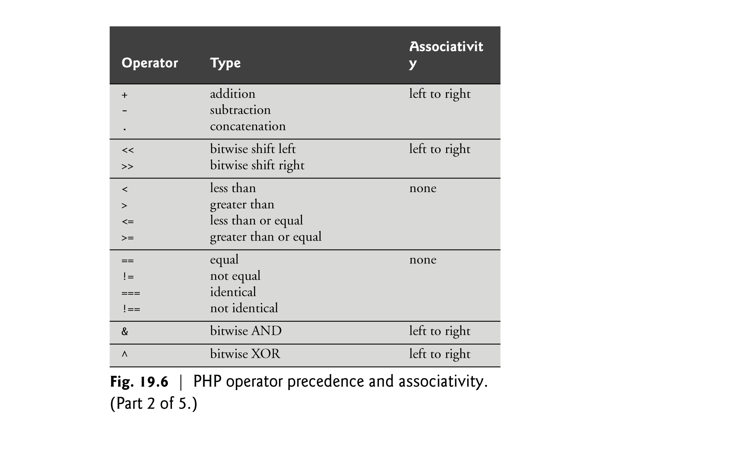

Slide 30
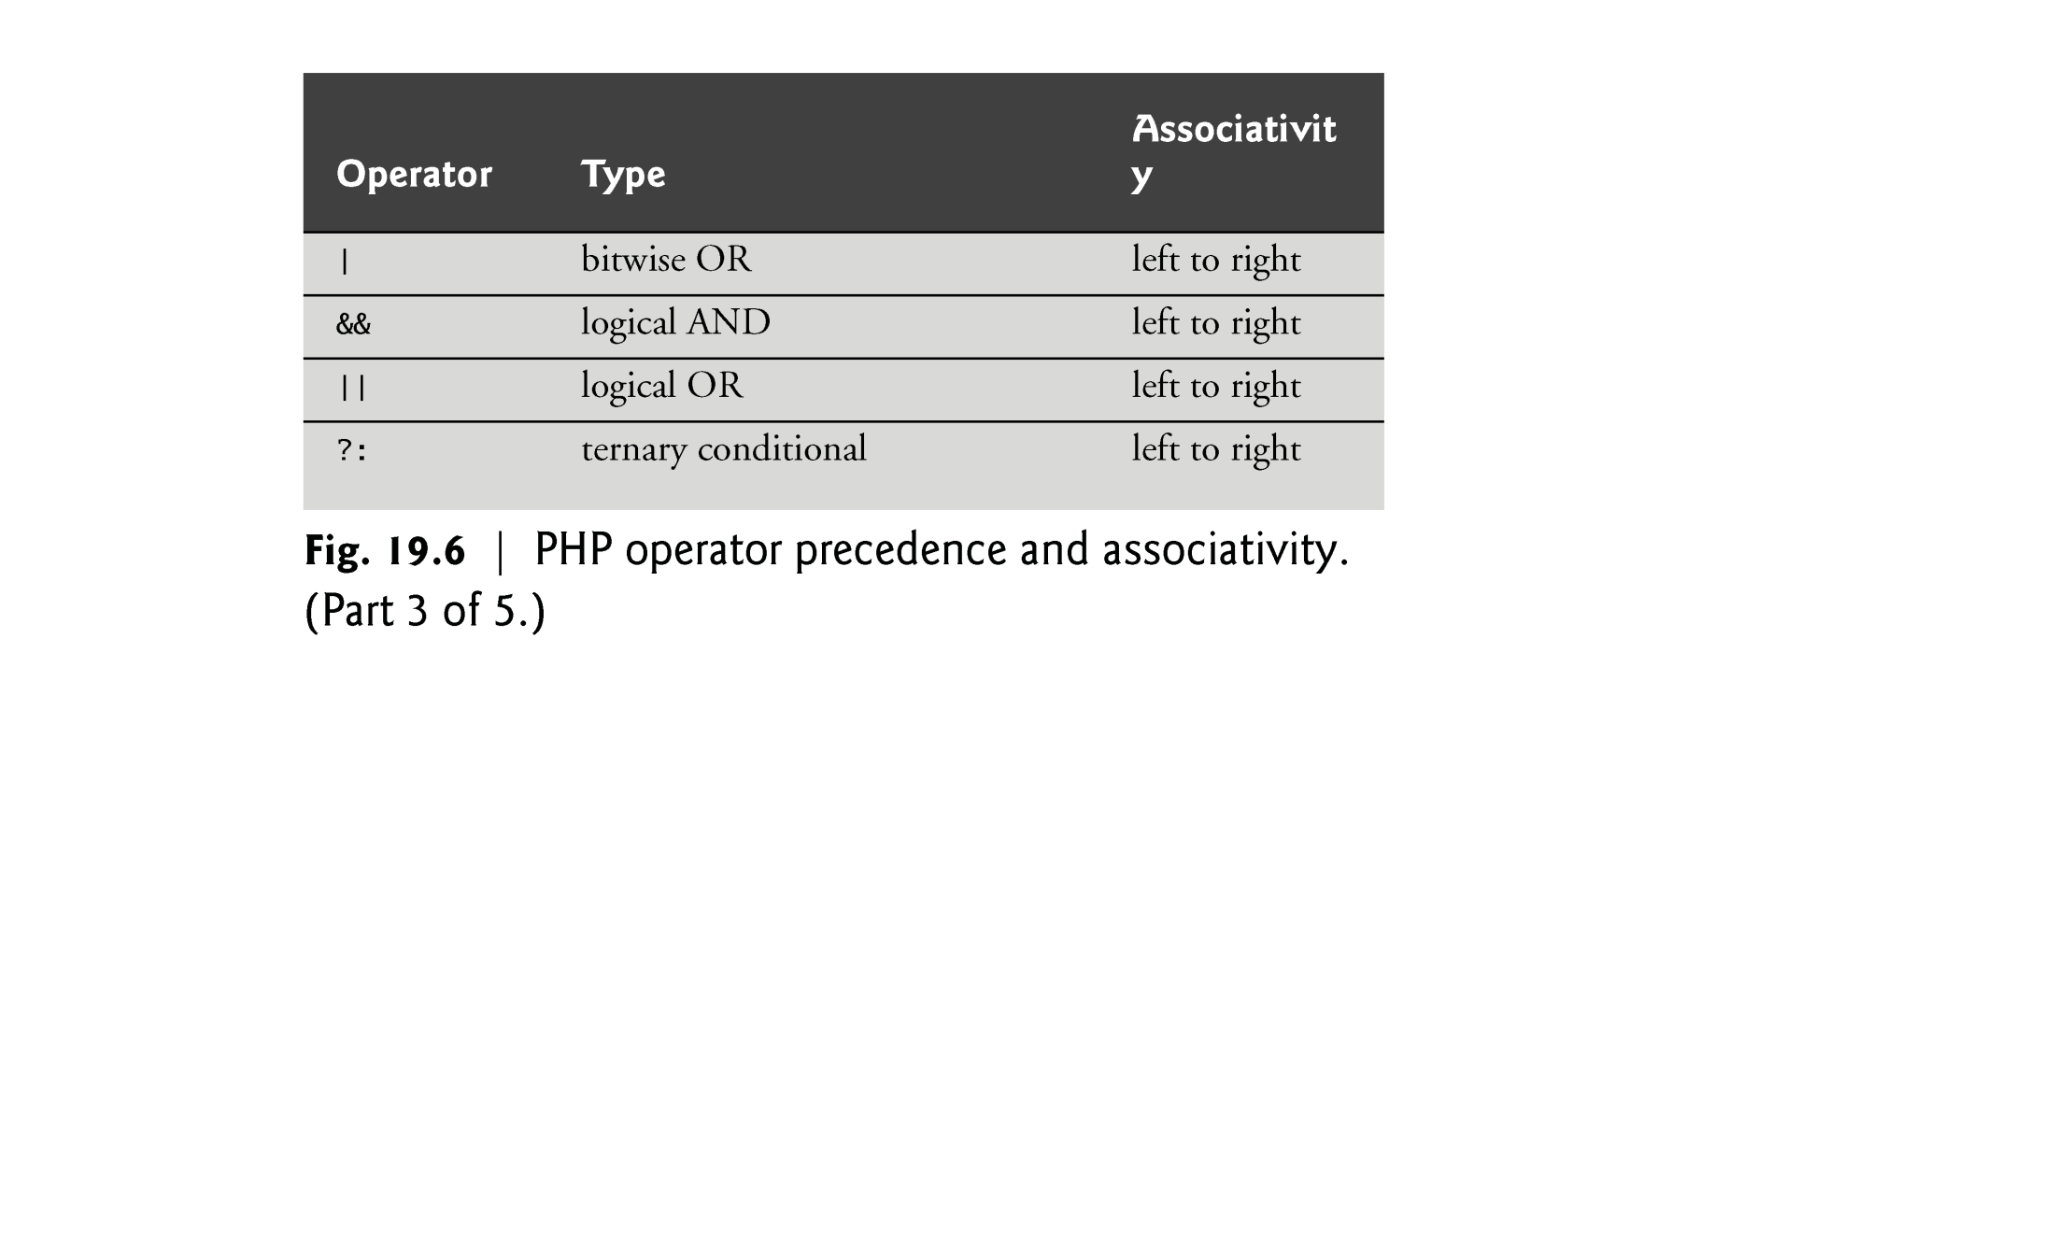

Slide 31
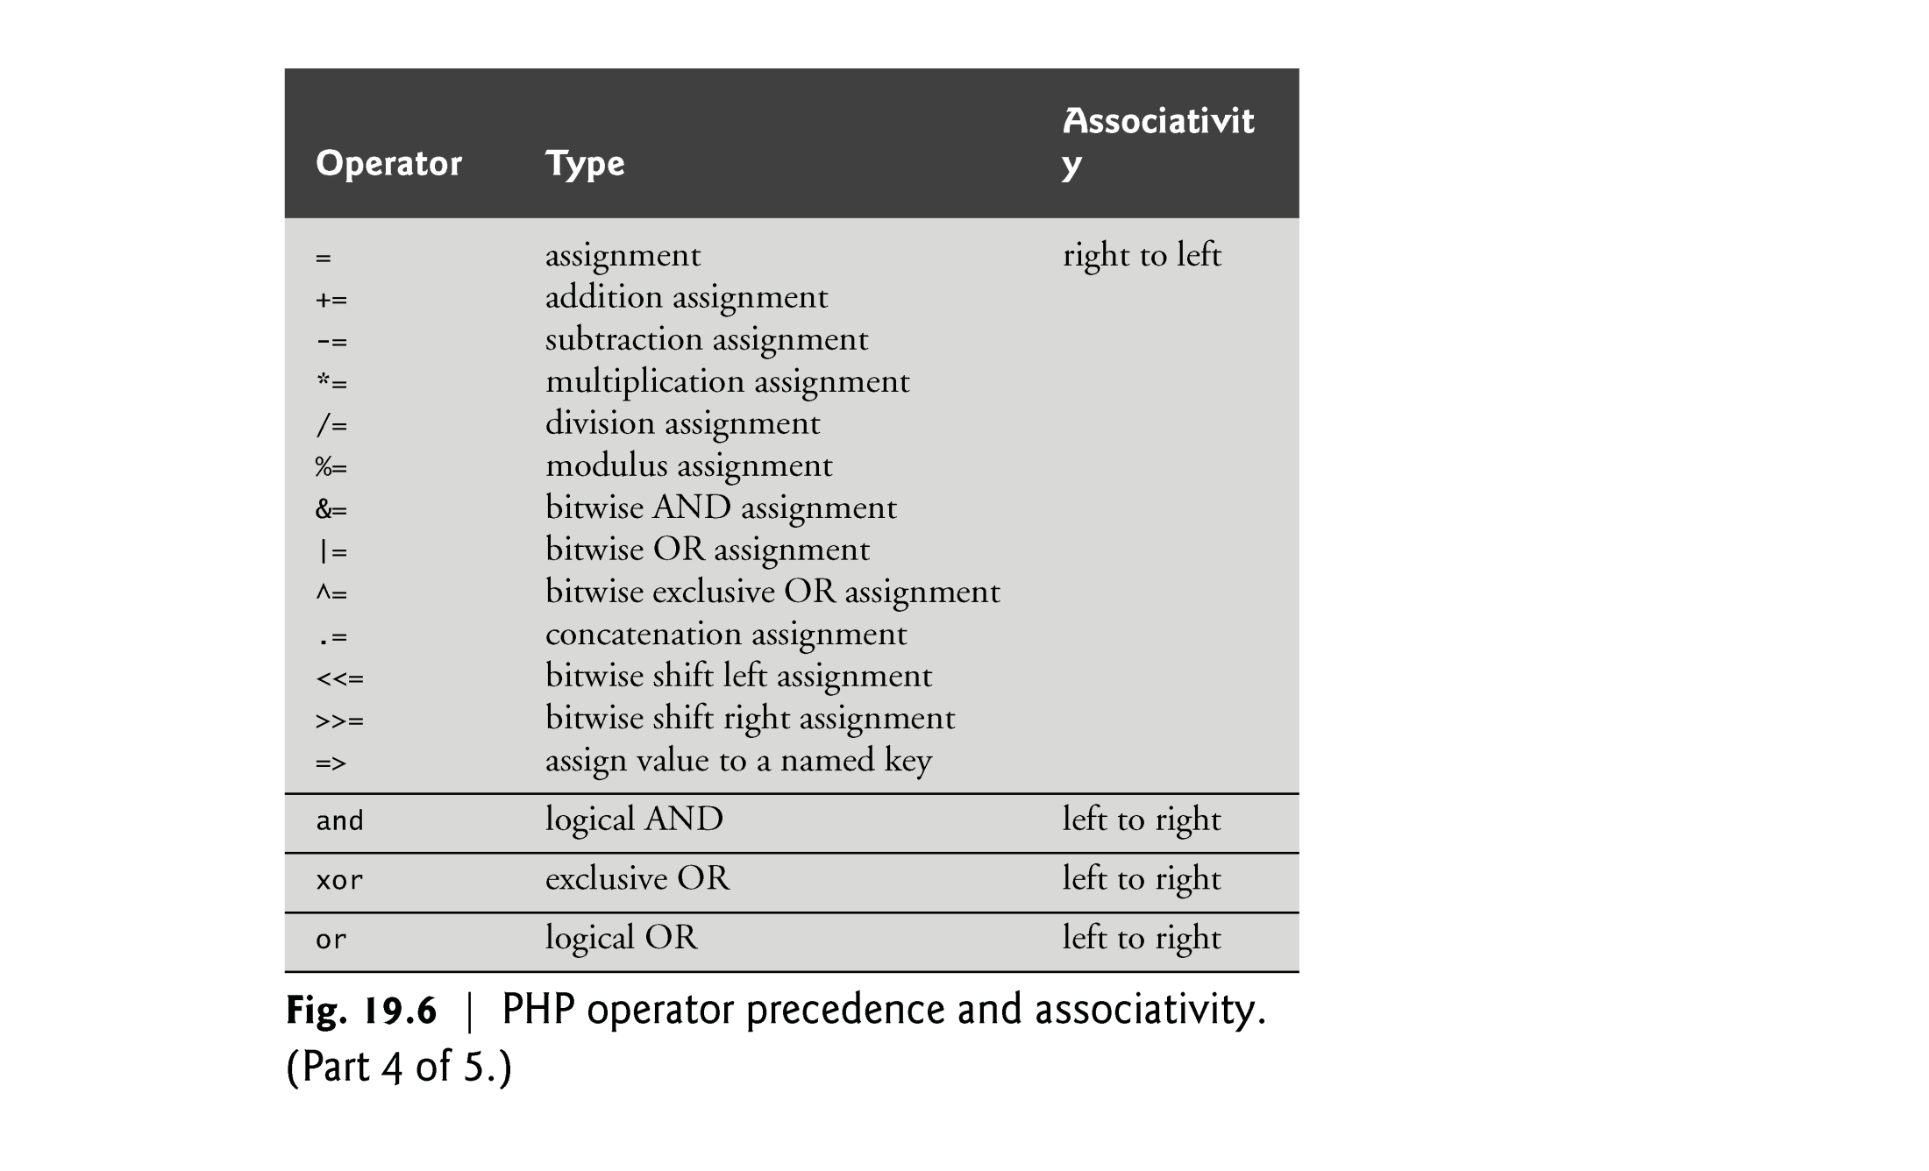

Slide 32
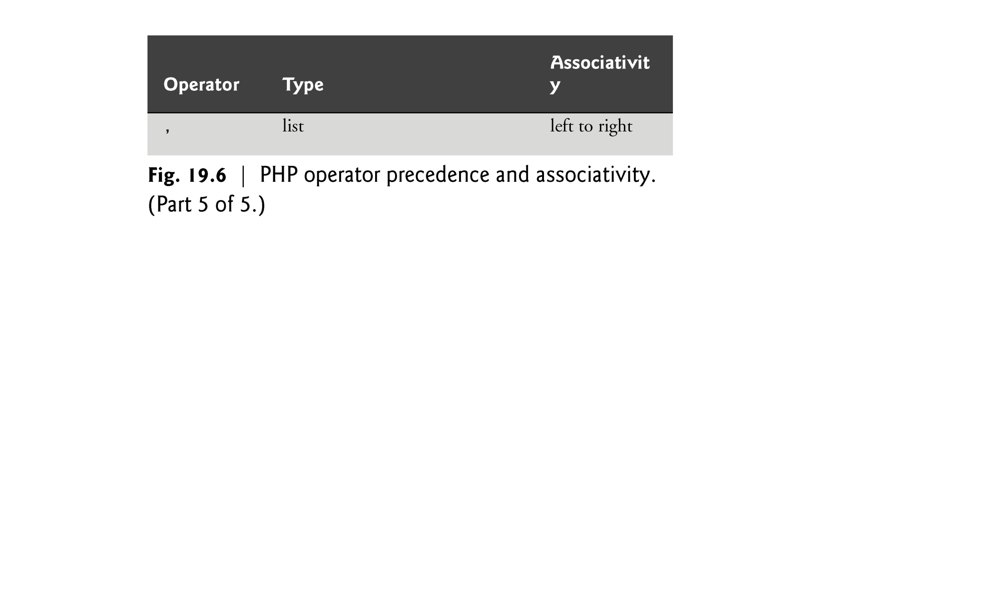

Slide 33
19.5 Initializing and Manipulating Arrays
PHP provides the capability to store data in arrays. Arrays are divided into elements that behave as individual variables. Array names, like other variables, begin with the $ symbol.
Individual array elements are accessed by following the array’s variable name with an index enclosed in square brackets ([]).
If a value is assigned to an array element of an array that does not exist, then the array is created. Likewise, assigning a value to an element where the index is omitted appends a new element to the end of the array.
Function count returns the total number of elements in the array.
Function array creates an array that contains the arguments passed to it. The first item in the argument list is stored as the first array element (index 0), the second item is stored as the second array element and so on.

Slide 34
19.5 Initializing and Manipulating Arrays (Cont.)
Arrays with nonnumeric indices are called associative arrays.
You can create an associative array using the operator =>, where the value to the left of the operator is the array index and the value to the right is the element’s value.
PHP provides functions for iterating through the elements of an array.
Each array has a built-in internal pointer, which points to the array element currently being referenced.
Function reset sets the internal pointer to the first array element. Function key returns the index of the element currently referenced by the internal pointer, and function next moves the internal pointer to the next element.

Slide 35
19.5 Initializing and Manipulating Arrays (Cont.)
The foreach statement, designed for iterating through arrays, starts with the array to iterate through, followed by the keyword as, followed by two variables—the first is assigned the index of the element and the second is assigned the value of that index’s element. (If only one variable is listed after as, it is assigned the value of the array element.)

Slide 36
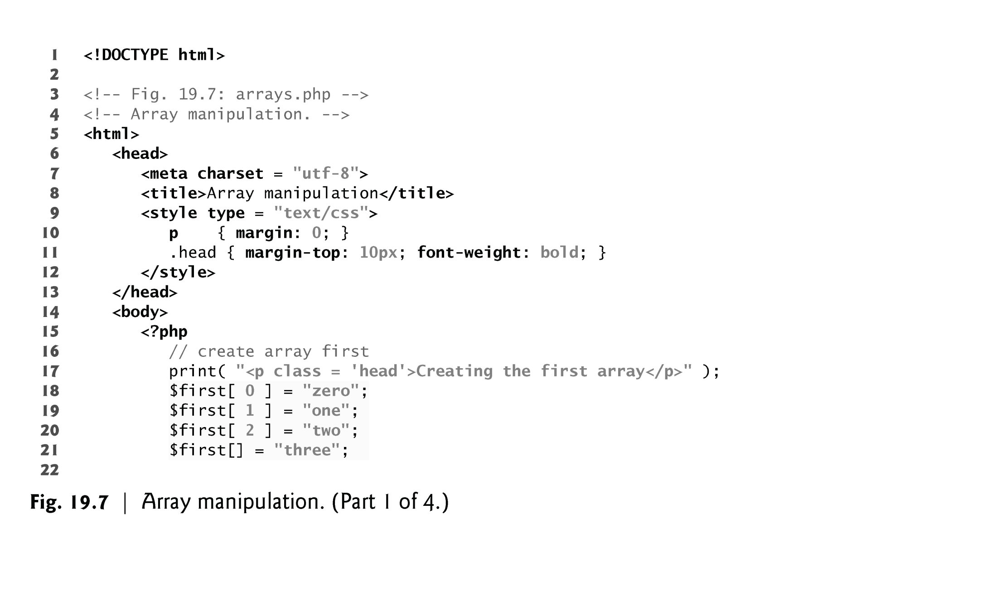

Slide 37
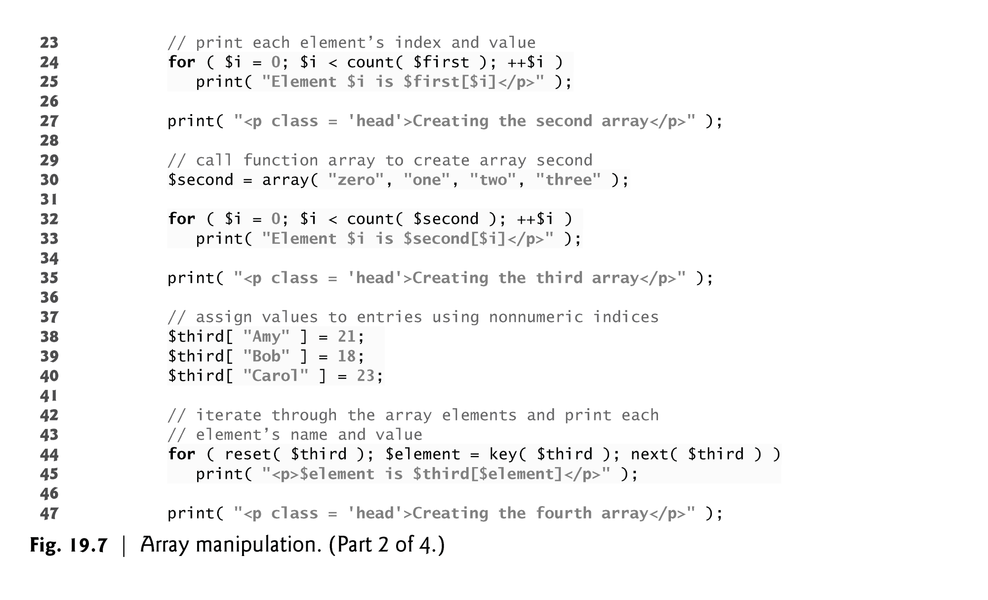

Slide 38
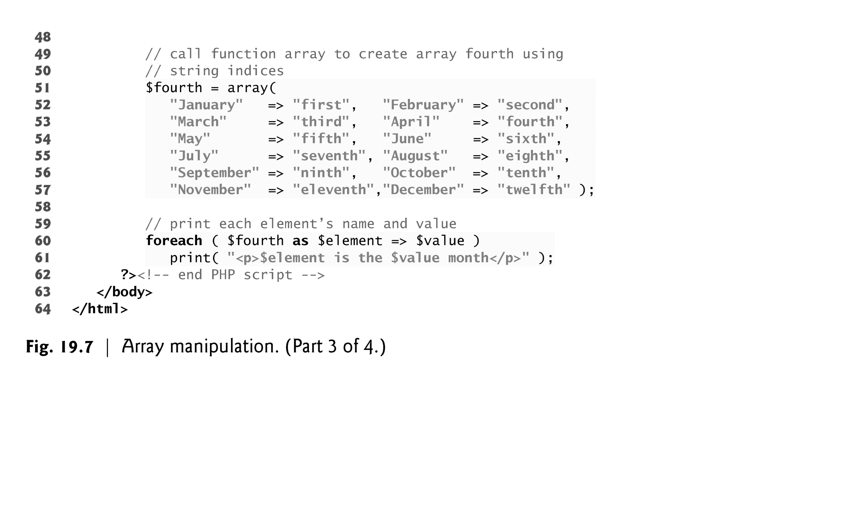

Slide 39
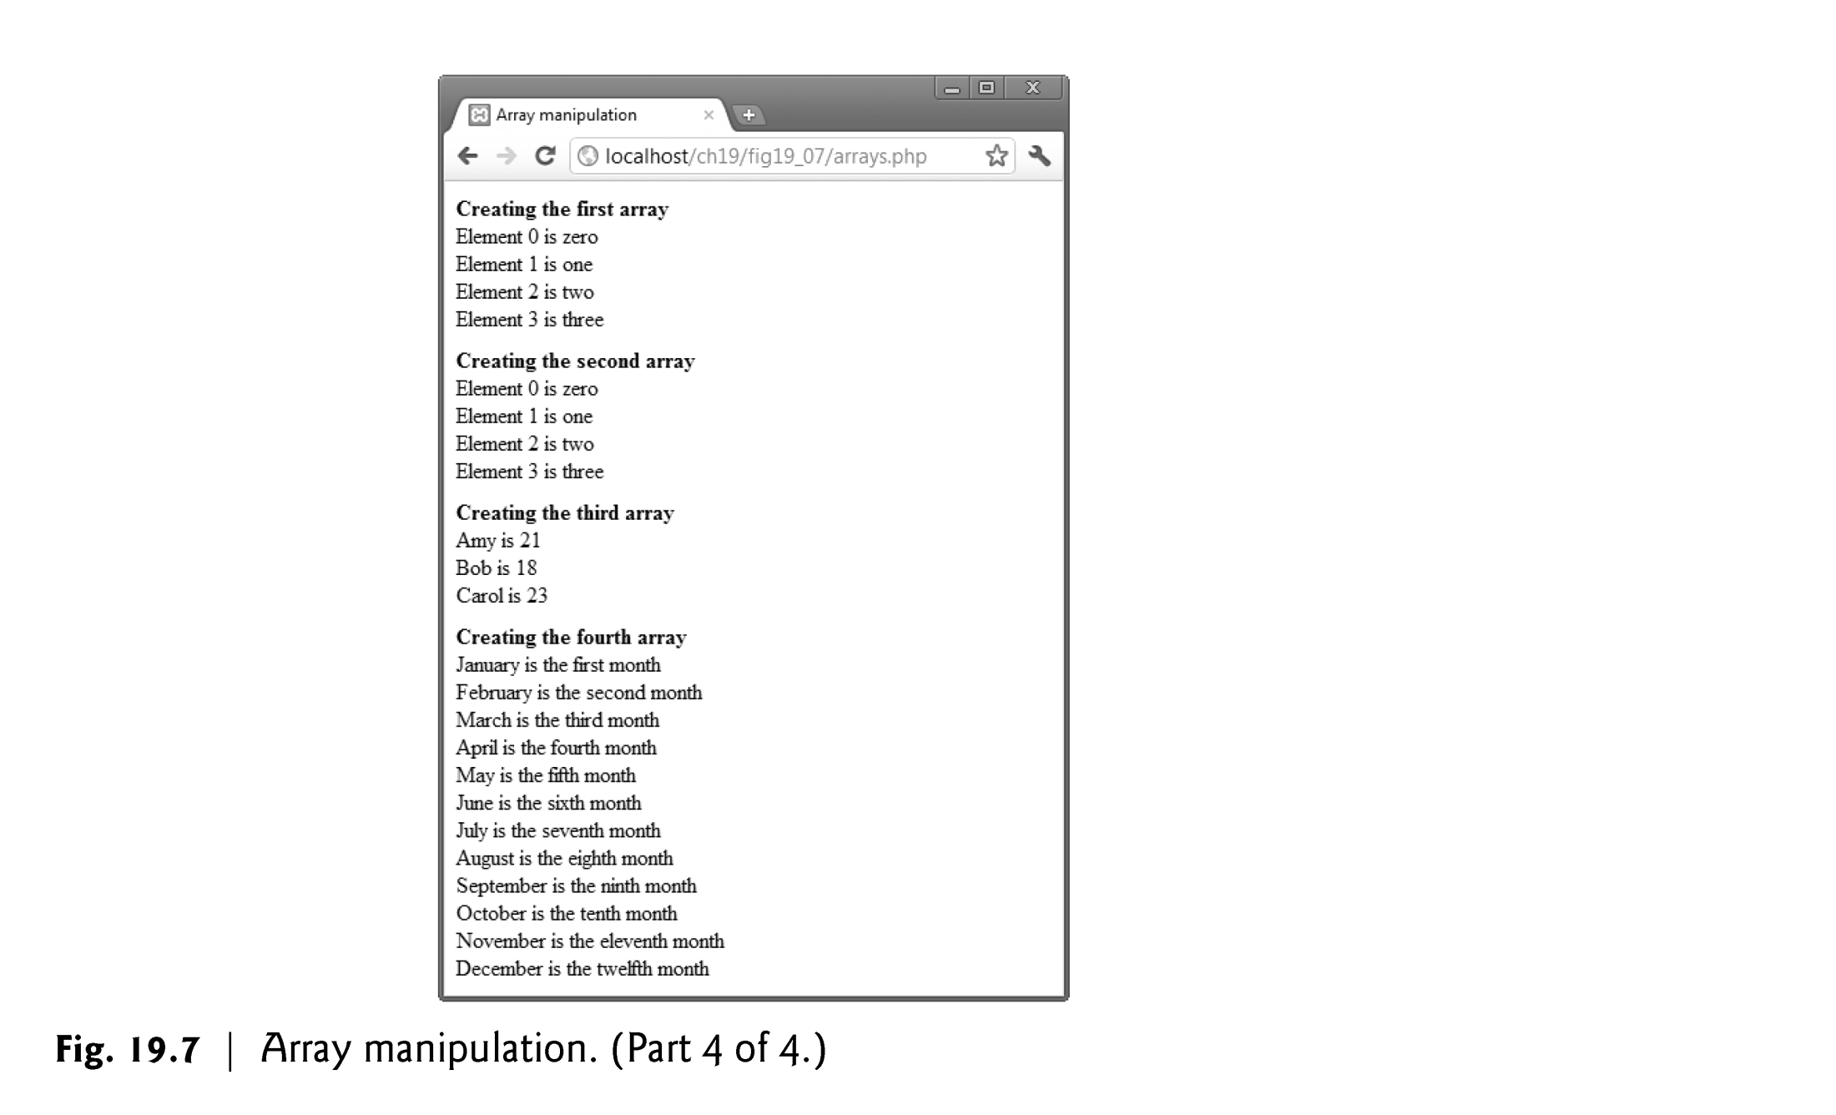

Slide 40
19.6 String Comparisons
Many string-processing tasks can be accomplished using the equality and relational operators (==, !=, <, <=, > and >=).
Function strcmp compares two strings. The function returns -1 if the first string alphabetically precedes the second string, 0 if the strings are equal, and 1 if the first string alphabetically follows the second.

Slide 41
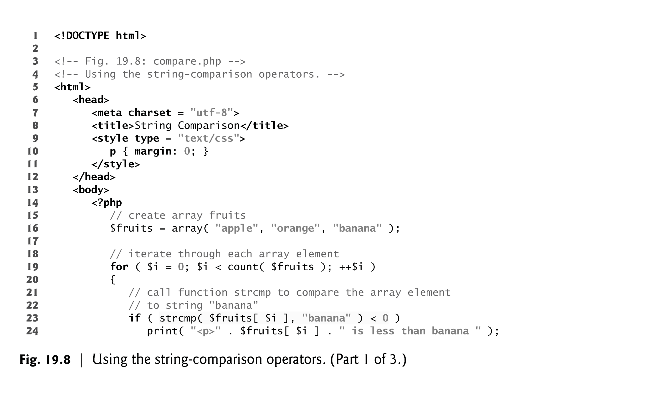

Slide 42
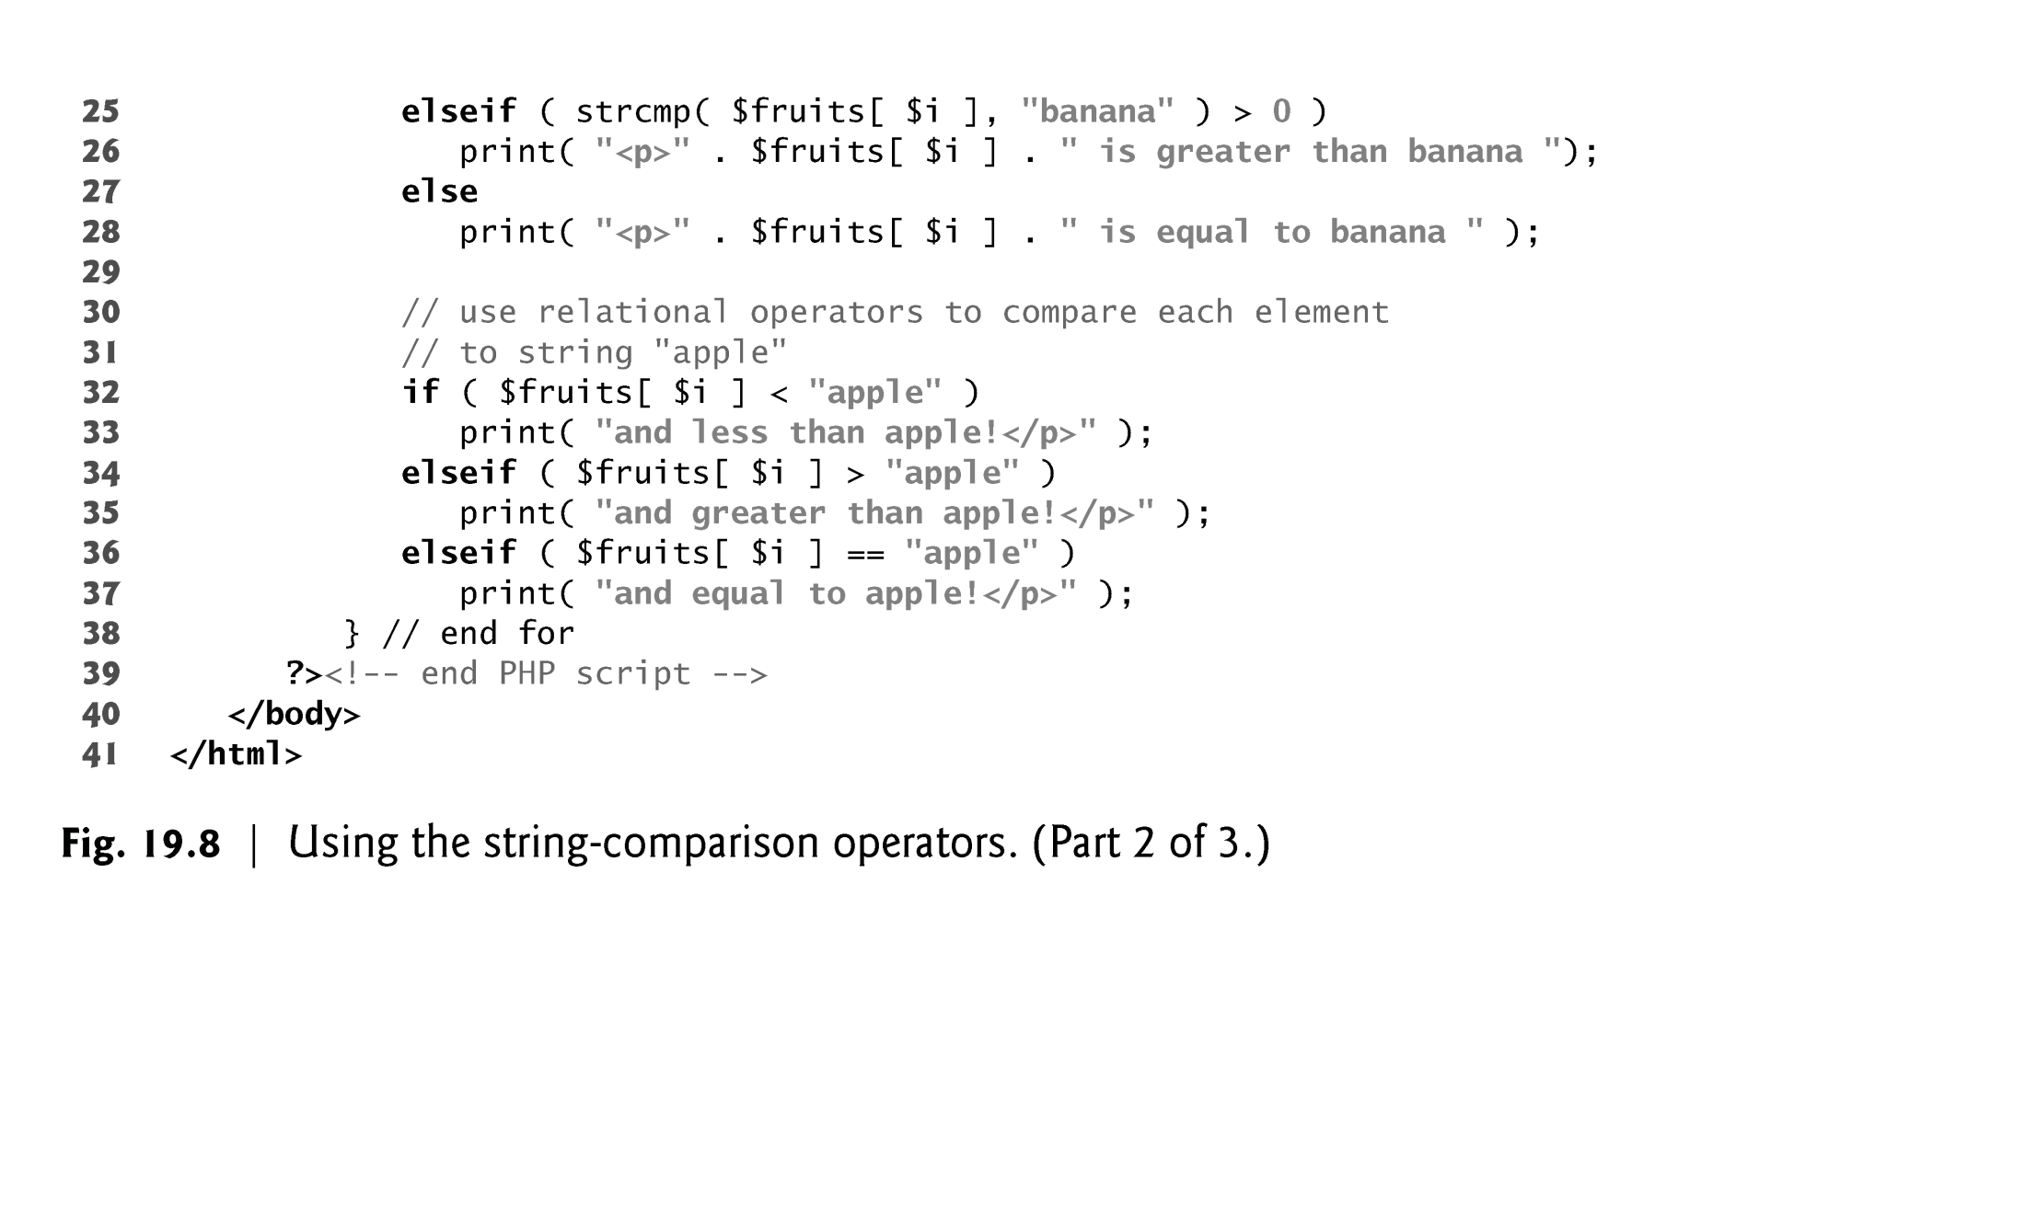

Slide 43
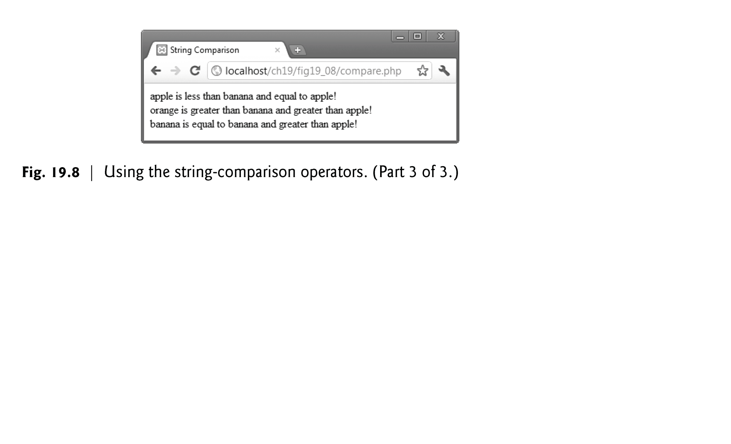

Slide 44
19.7 String Processing with Regular Expressions
Text manipulation is usually done with regular expressions—a series of characters that serve as pattern-matching templates (or search criteria) in strings, text files and databases.
Function preg_match uses regular expressions to search a string for a specified pattern using Perl-compatible regular expressions (PCRE).
If a pattern is found, preg_match returns the length of the matched string—which evaluates to true in a boolean context.
Anything enclosed in single quotes in a print statement is not interpolated, unless the single quotes are nested in a double-quoted string literal.
Function preg_match takes two arguments—a regular-expression pattern to search for and the string to search.
Function preg_match performs case-insensitive pattern matches.

Slide 45
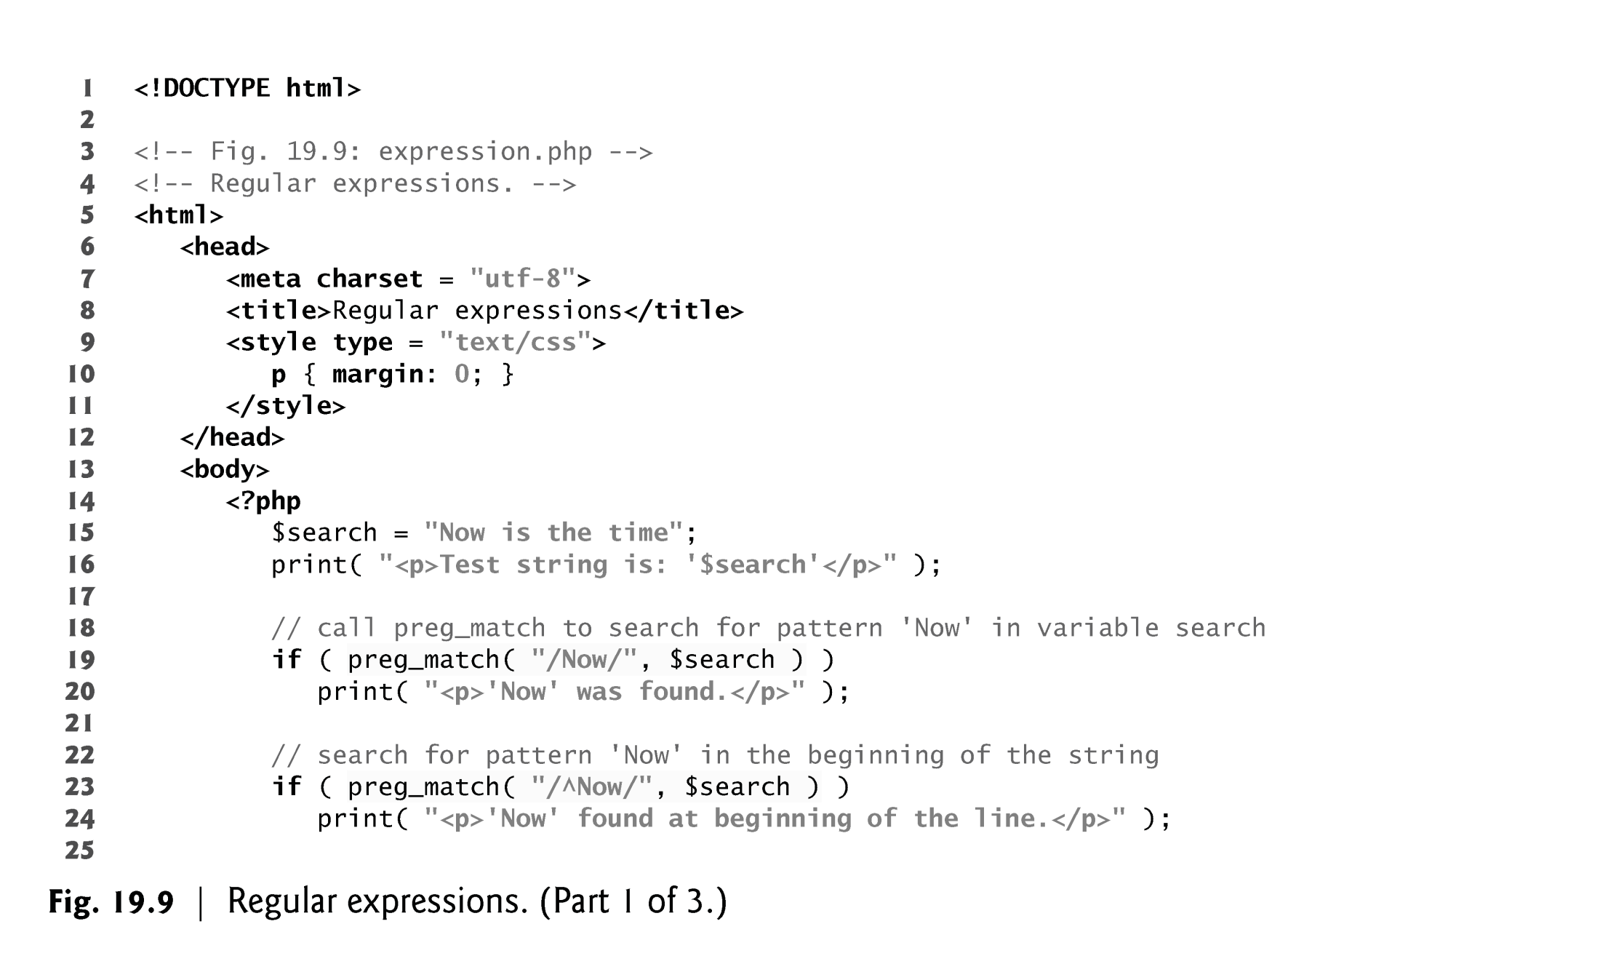

Slide 46
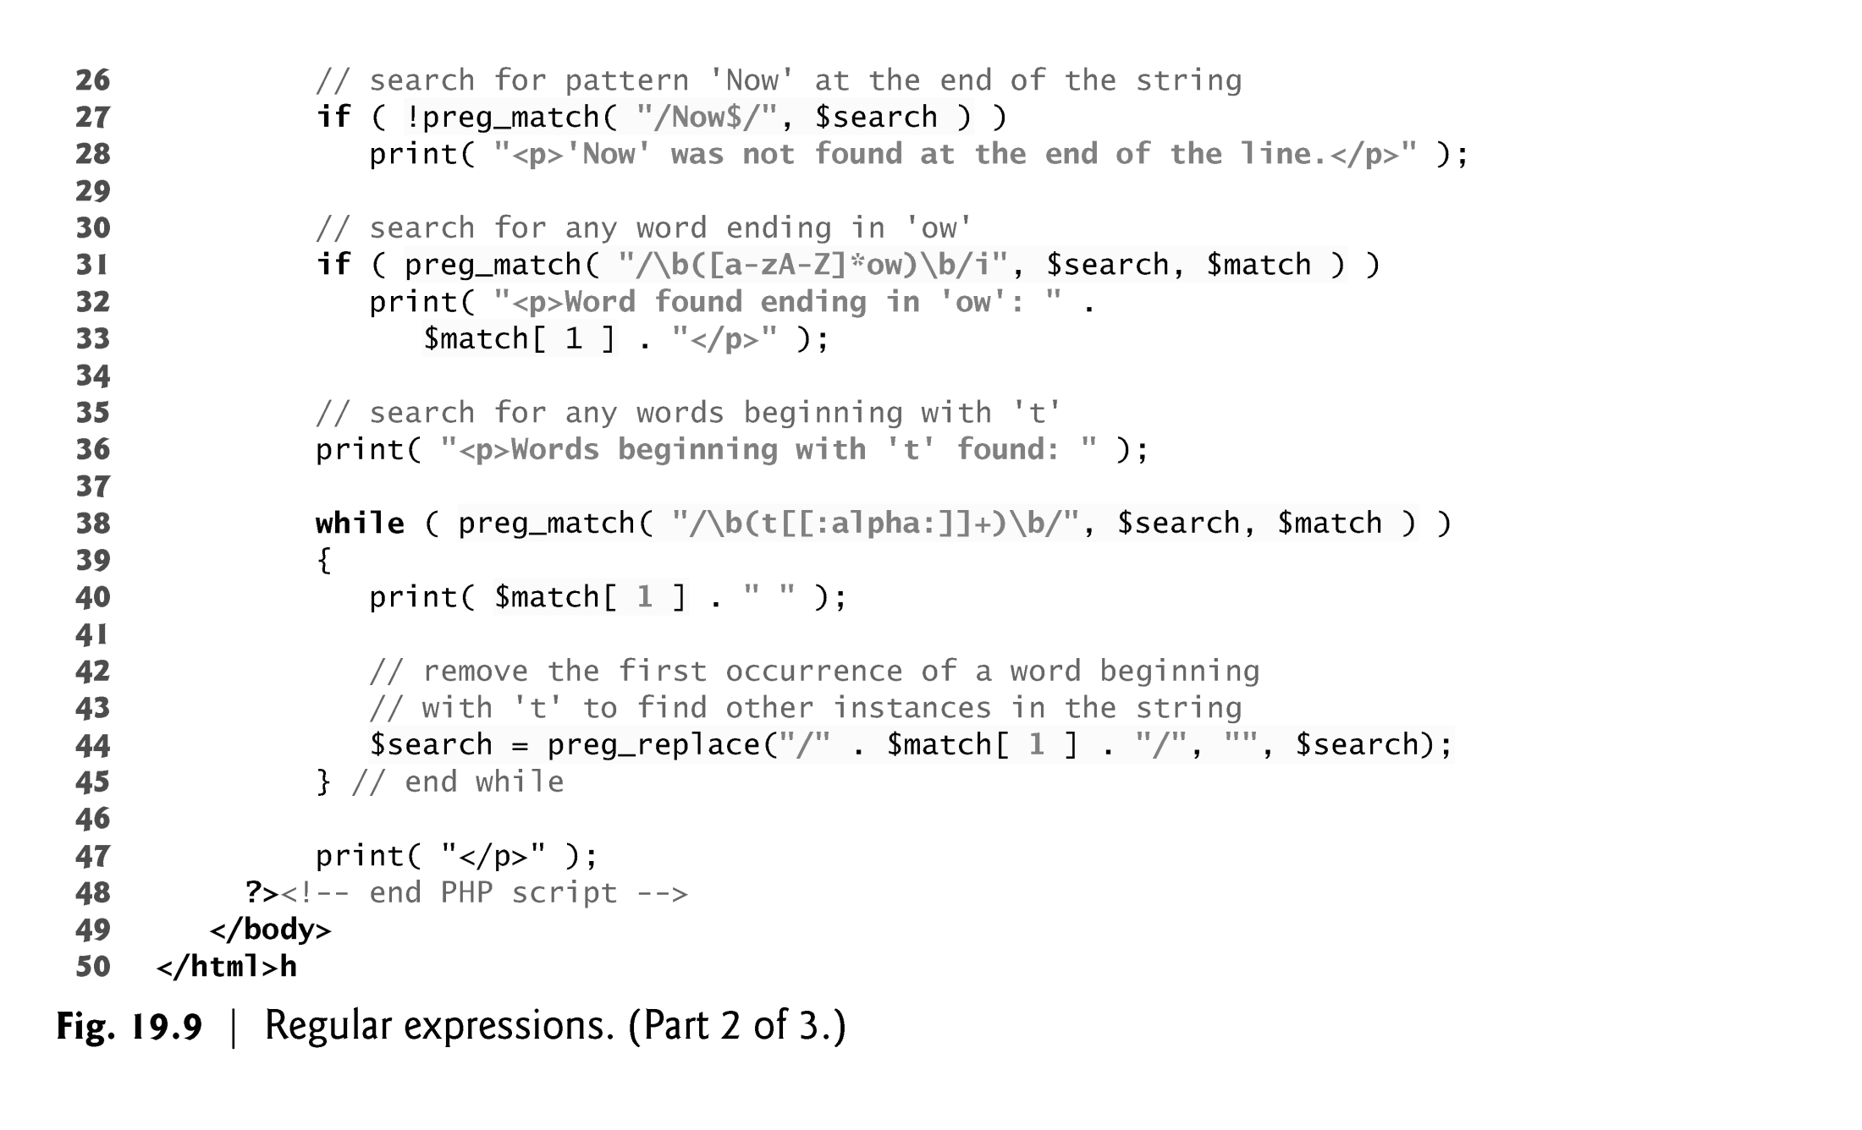

Slide 47
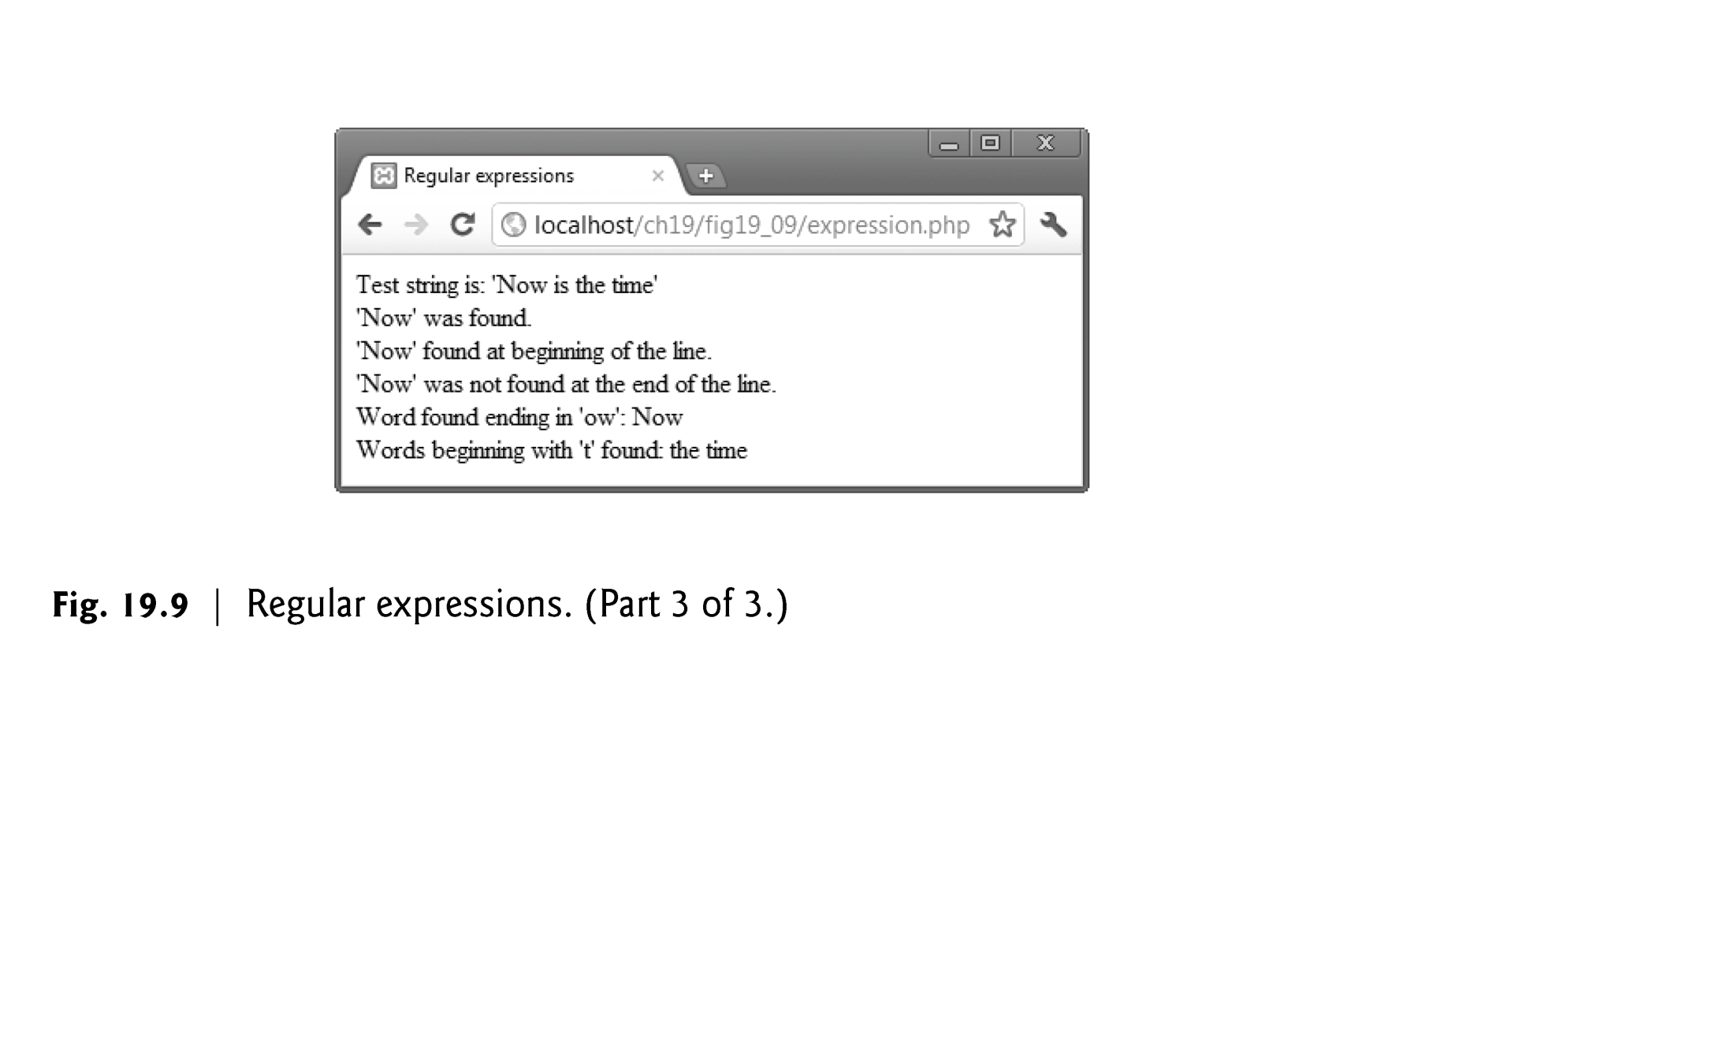

Slide 48
19.7.2 Representing Patterns
Regular expressions can include metacharacters such as ^, $ and . that specify patterns.
For example, the caret (^) metacharacter matches the beginning of a string, while the dollar sign ($) matches the end of a string.
The period (.) metacharacter matches any single character.
Bracket expressions are lists of characters enclosed in square brackets ([]) that match any single character from the list.
Ranges can be specified by supplying the beginning and the end of the range separated by a dash (-).

Slide 49
19.7.2 Representing Patterns
The \b before and after the parentheses indicates the beginning and end of a word, respectively—in other words, we’re attempting to match whole words.
Quantifiers are used in regular expressions to denote how often a particular character or set of characters can appear in a match.

Slide 50
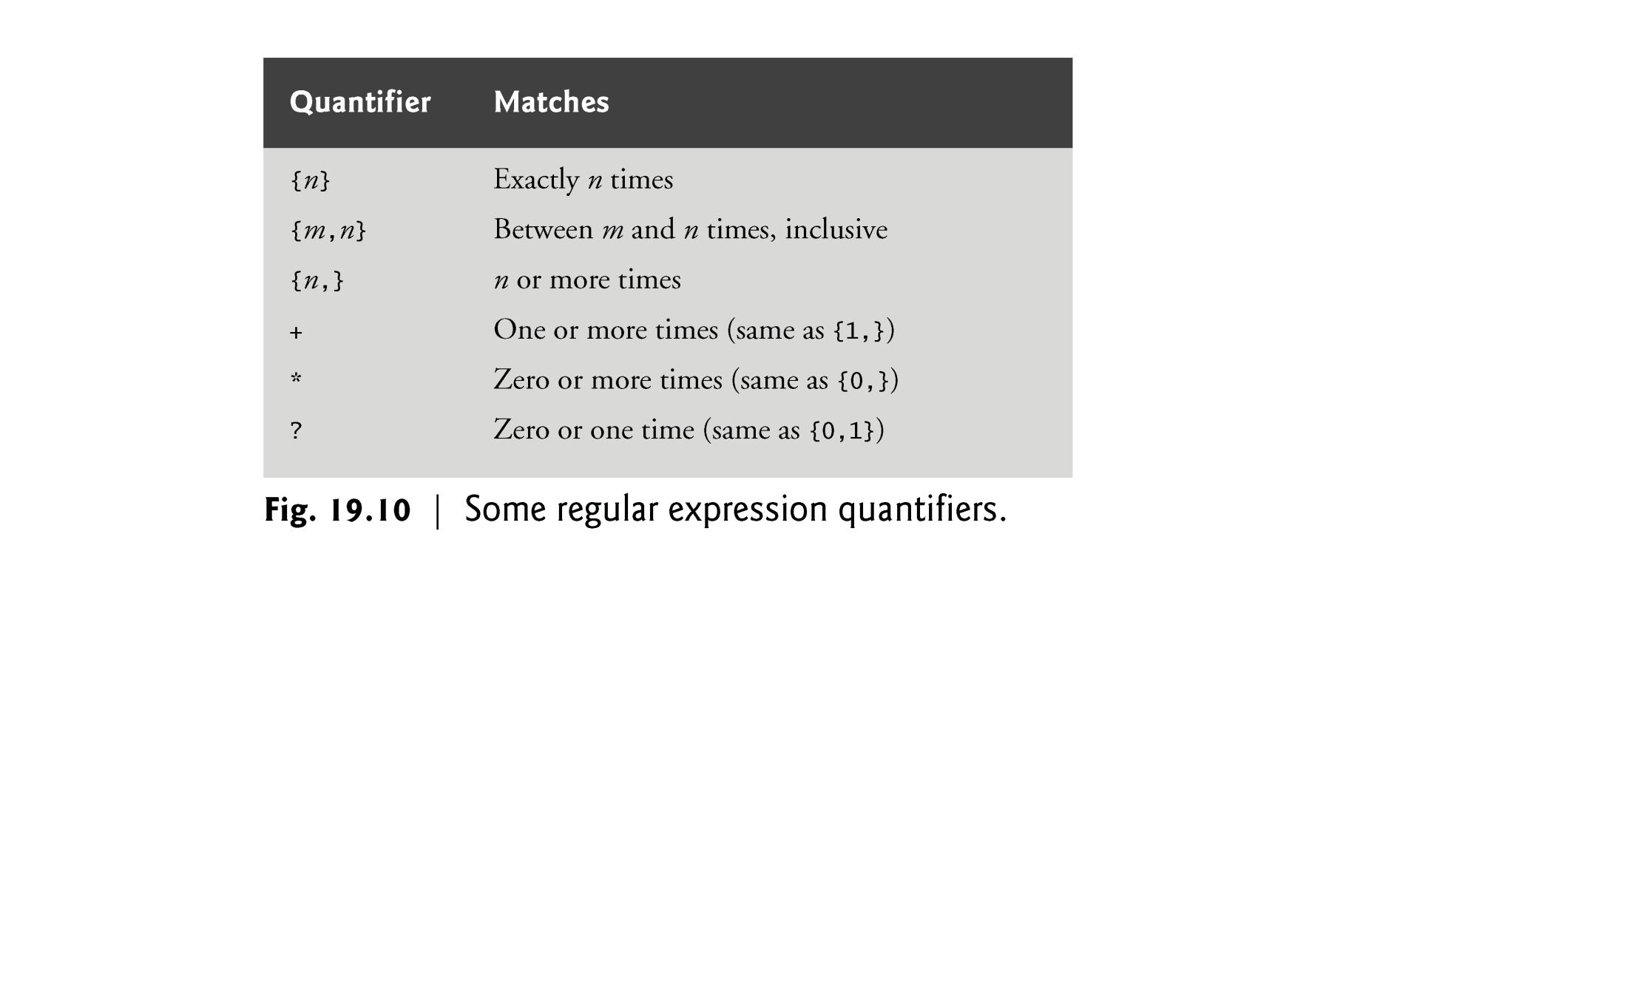

Slide 51
19.7.3 Finding Matches
The optional third argument to function preg _match is an array that stores matches to each parenthetical statement of the regular expression.
The first element stores the string matched for the entire pattern, and the remaining elements are indexed from left to right.
To find multiple instances of a given pattern, we must make multiple calls to preg_match, and remove matched instances before calling the function again by using a function such as preg_replace.

Slide 52
19.7.4 Character Classes
Character classes are enclosed by the delimiters [: and :].
When this expression is placed in another set of brackets, it is a regular expression matching all of the characters in the class.
A bracketed expression containing two or more adjacent character classes in the class delimiters represents those character sets combined.

Slide 53
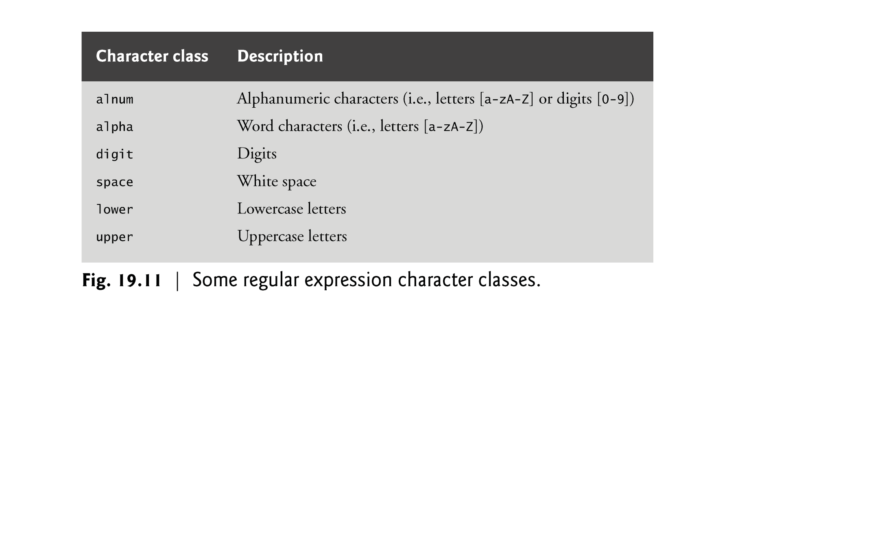

Slide 54
19.7.5 Finding Multiple Instances of a Pattern
Function preg_replace takes three arguments—
the pattern to match,
a string to replace the matched string and
the string to search. The modified string is returned.

Slide 55
19.8 Form Processing and Business Logic
Superglobal arrays are associative arrays predefined by PHP that hold variables acquired from user input, the environment or the web server and are accessible in any variable scope.
The arrays $_GET and $_POST retrieve information sent to the server by HTTP get and post requests, respectively.

Slide 56
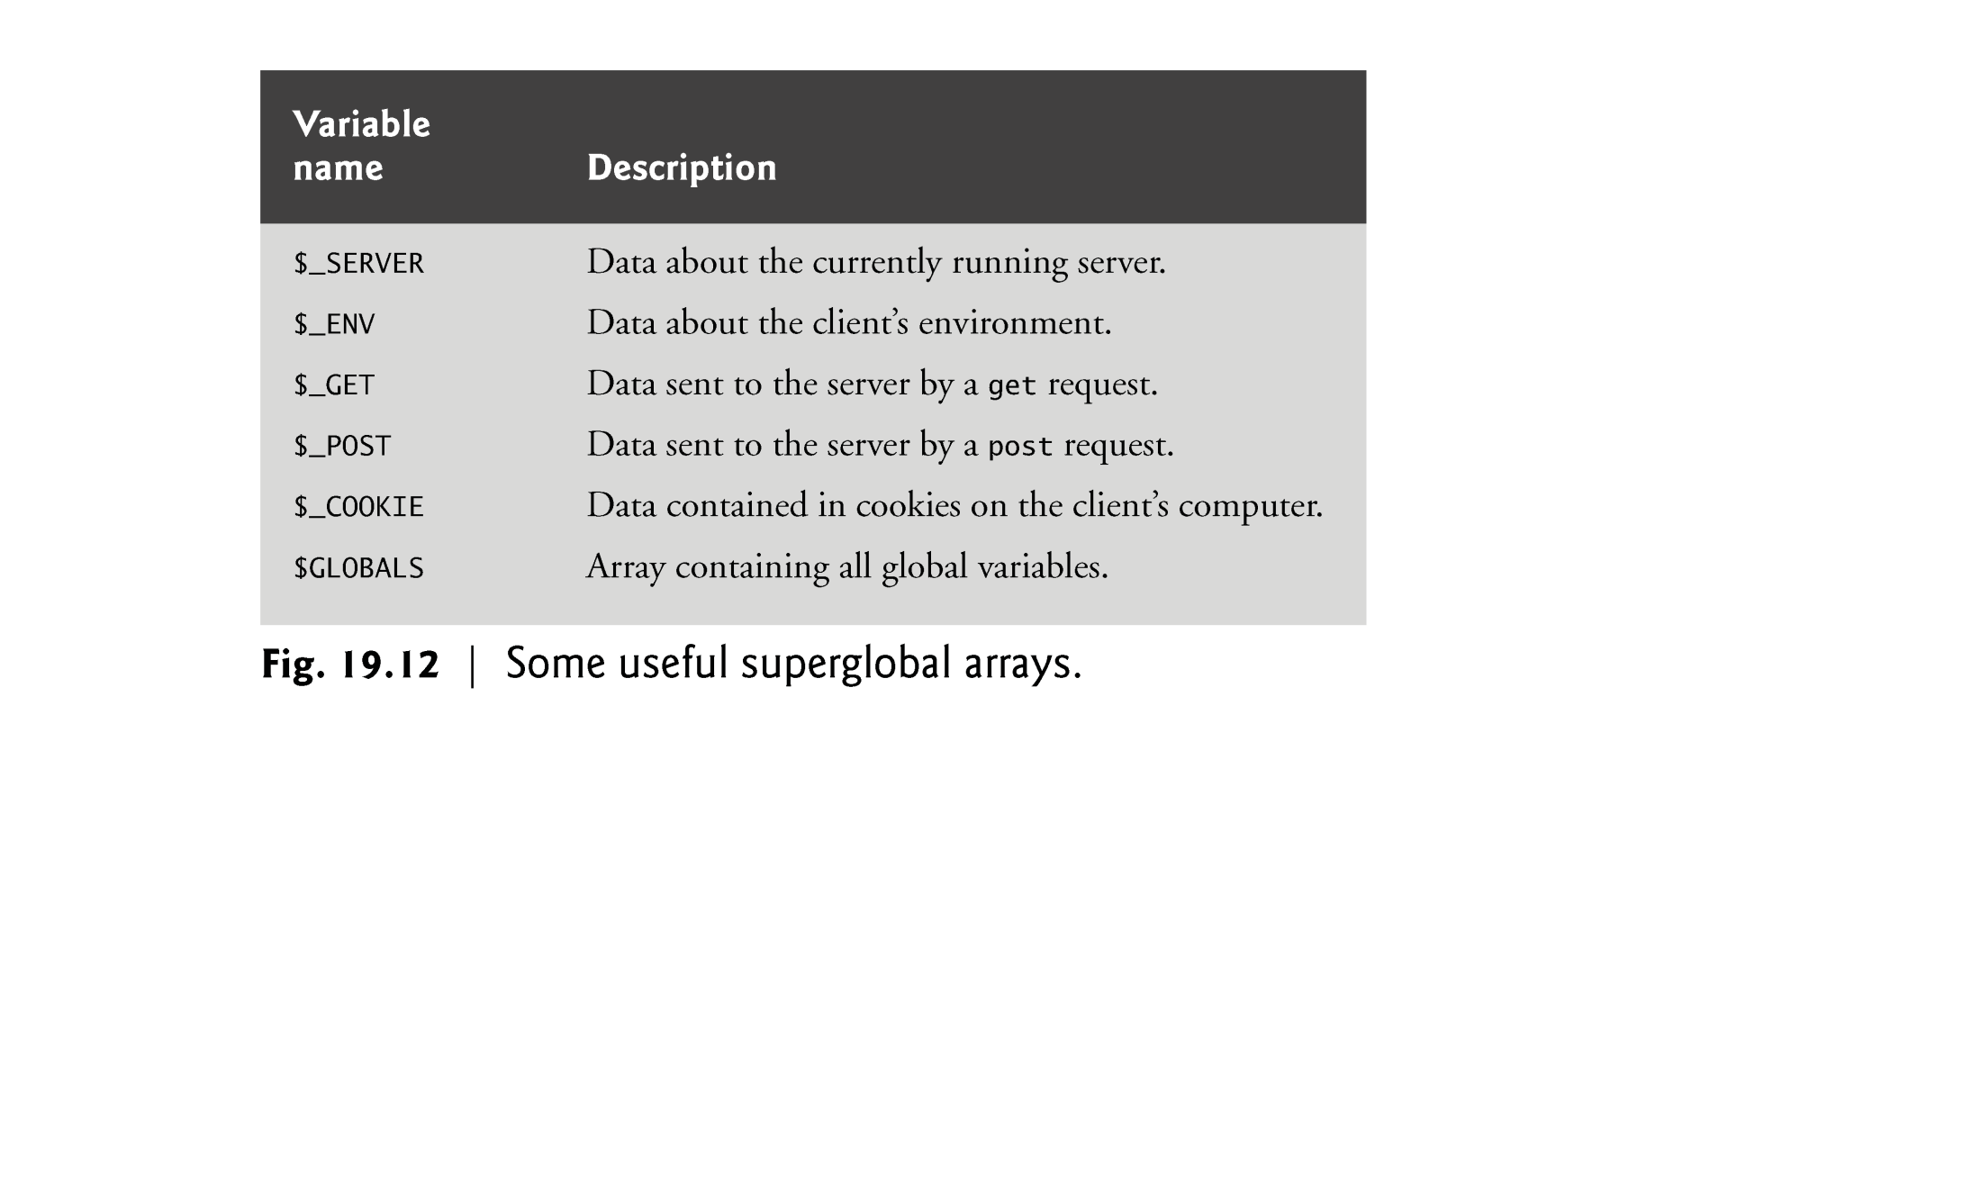

Slide 57
19.8.2 Using PHP to Process HTML5 Forms
Using method = "post" appends form data to the browser request that contains the protocol and the requested resource’s URL. Scripts located on the web server’s machine can access the form data sent as part of the request.

Slide 58
19.4 Form Processing and Business Logic (Cont.)
We escape the normal meaning of a character in a string by preceding it with the backslash character (\).
Function die terminates script execution. The function’s optional argument is a string, which is printed as the script exits.

Slide 59
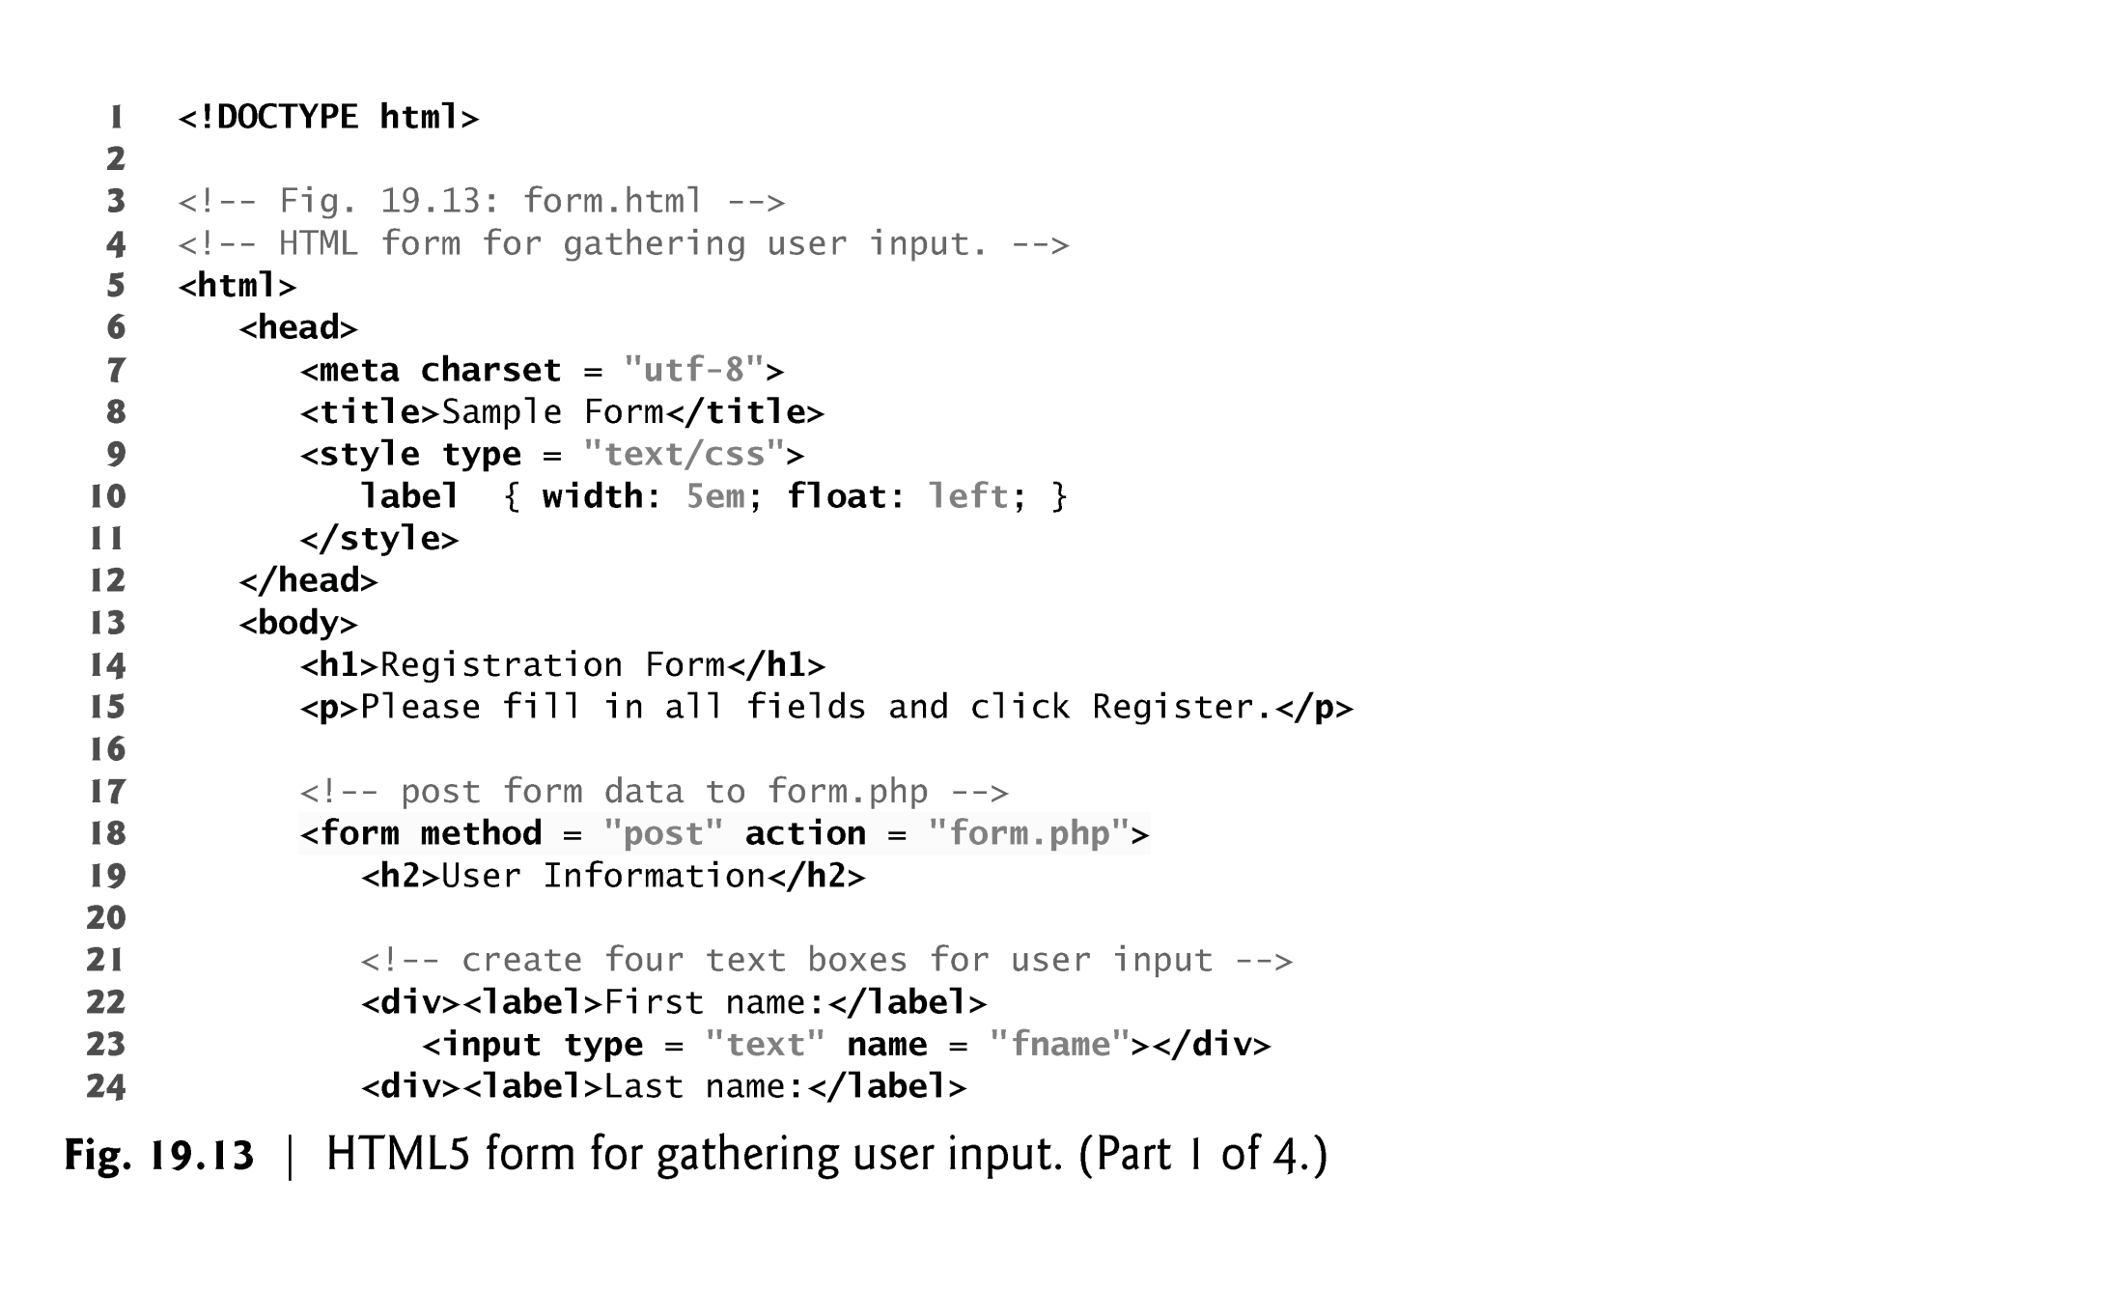

Slide 60
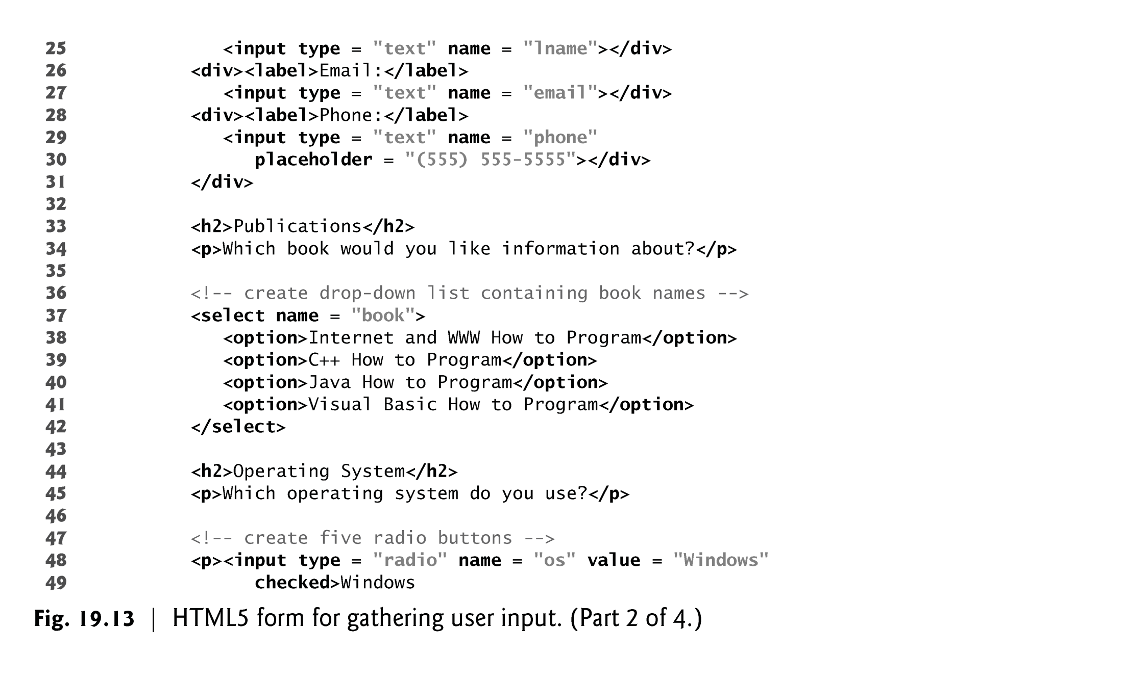

Slide 61
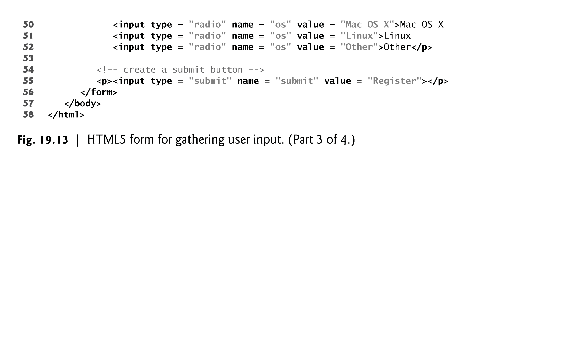

Slide 62
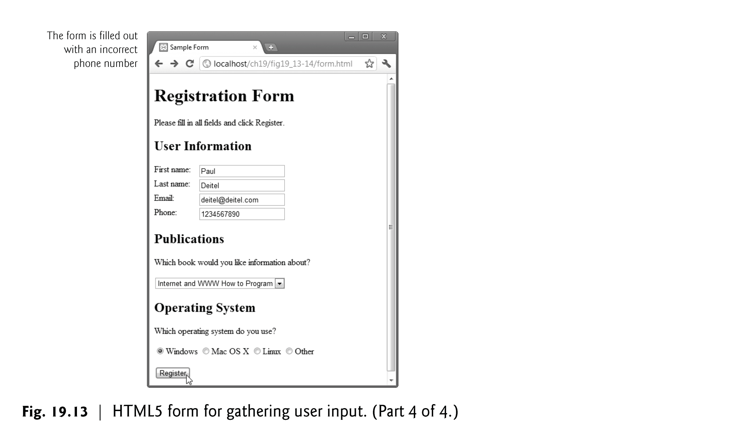

Slide 63
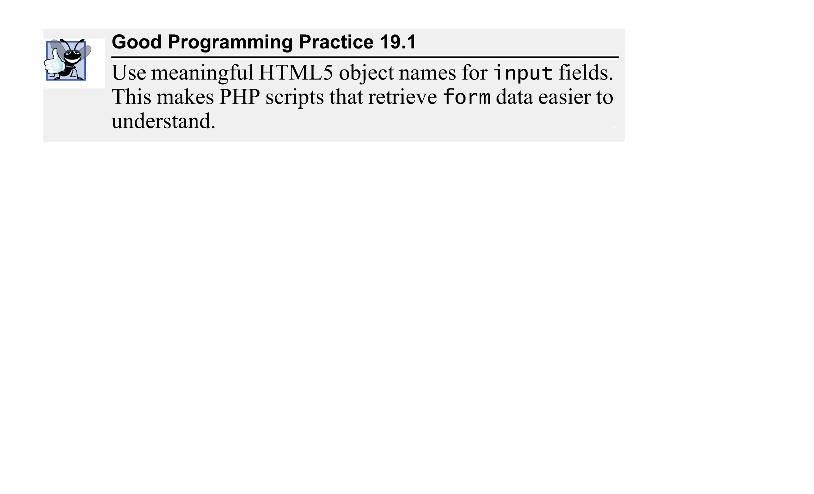

Slide 64
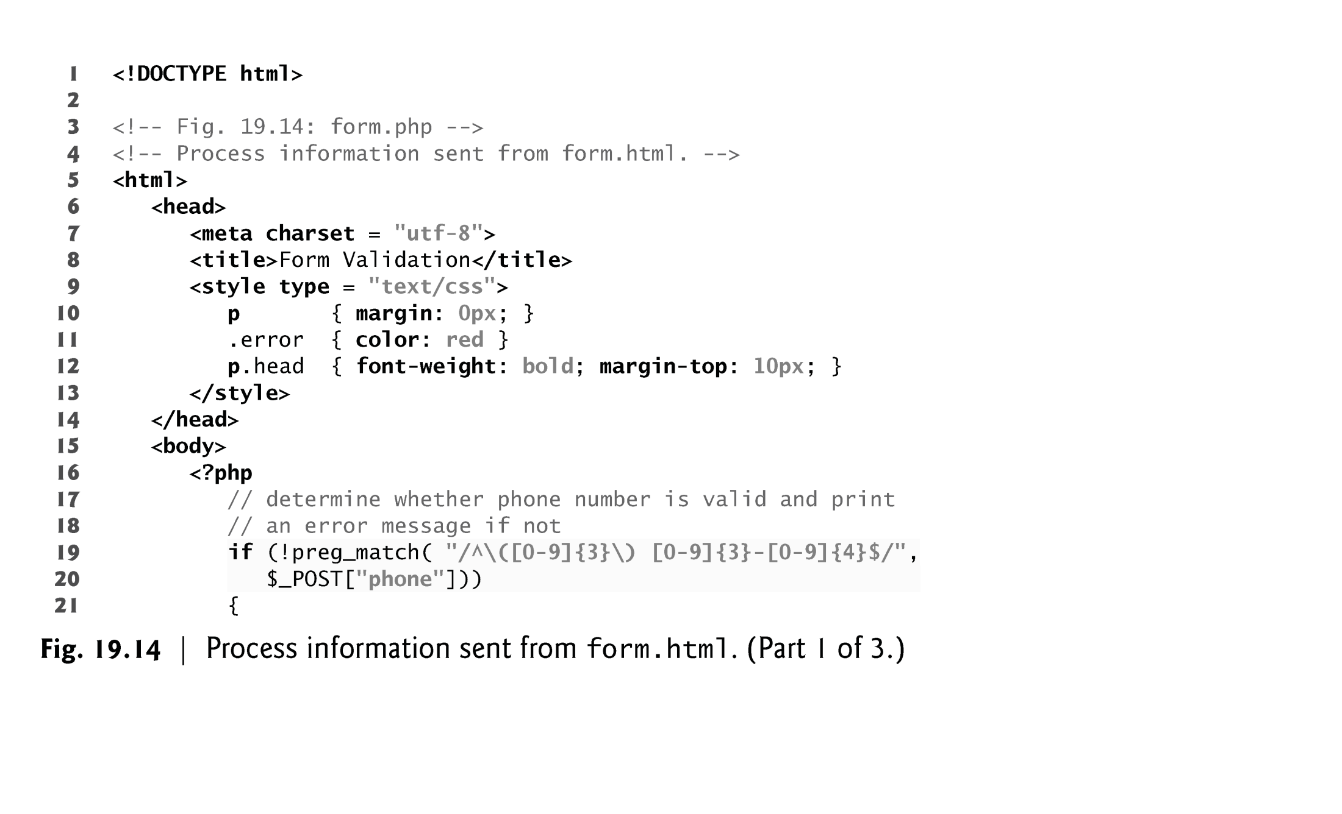

Slide 65
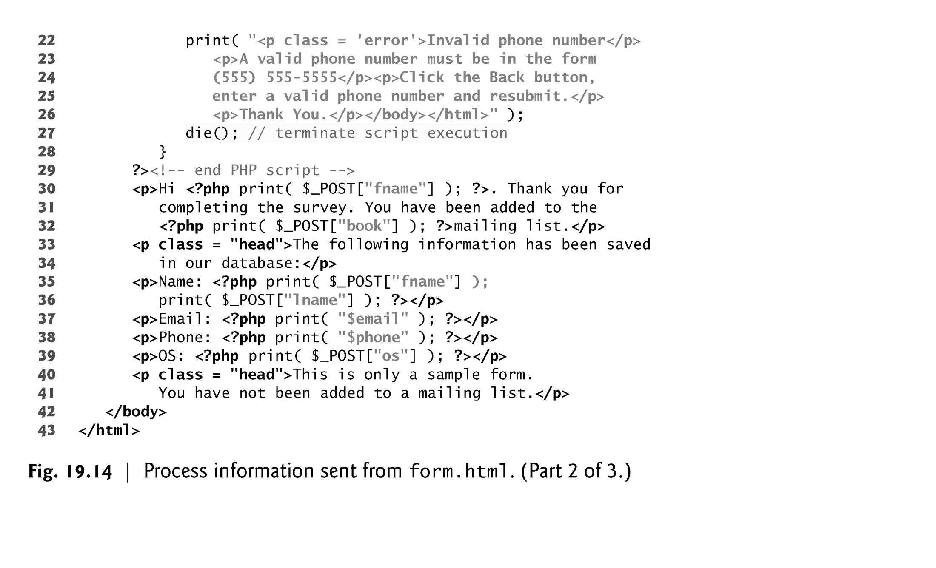

Slide 66
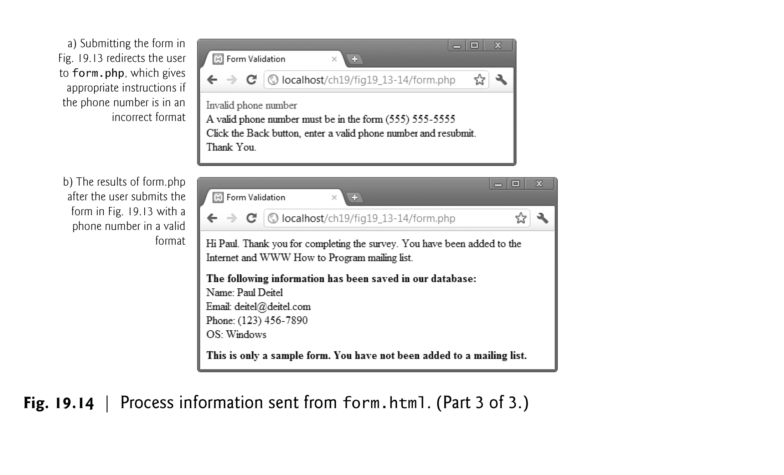

Slide 67
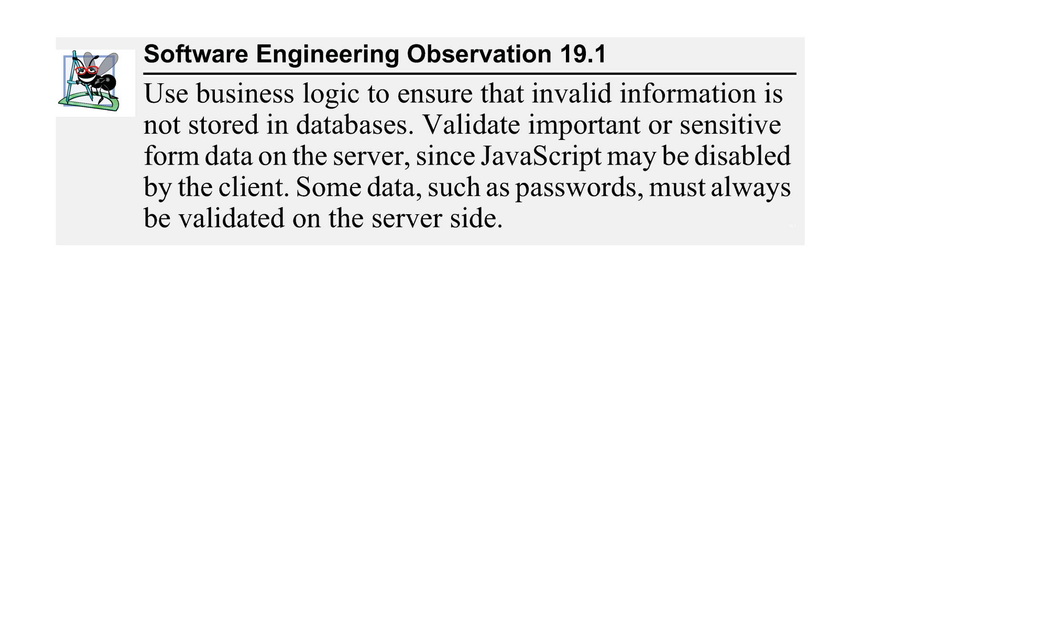

Slide 68
19.9 Reading from a Database
Function mysql_connect connects to the MySQL database. It takes three arguments—
the server’s hostname
a username
a password
and returns a database handle—a representation of PHP’s connection to the database, or false if the connection fails.
Function mysql_select_db selects and opens the database to be queried.
The function returns true on success or false on failure.

Slide 69
19.9 Reading from a Database (Cont.)
To query the database, we call function mysql_query, specifying the query string and the database to query.
This returns a resource containing the result of the query, or false if the query fails.
It can also execute SQL statements such as INSERT or DELETE that do not return results.
The mysql_error function returns any error strings from the database.
mysql_close closes the connection to the database specified in its argument.
The mysql_fetch_row function returns an array containing the values for each column in the current row of the query result ($result).

Slide 70
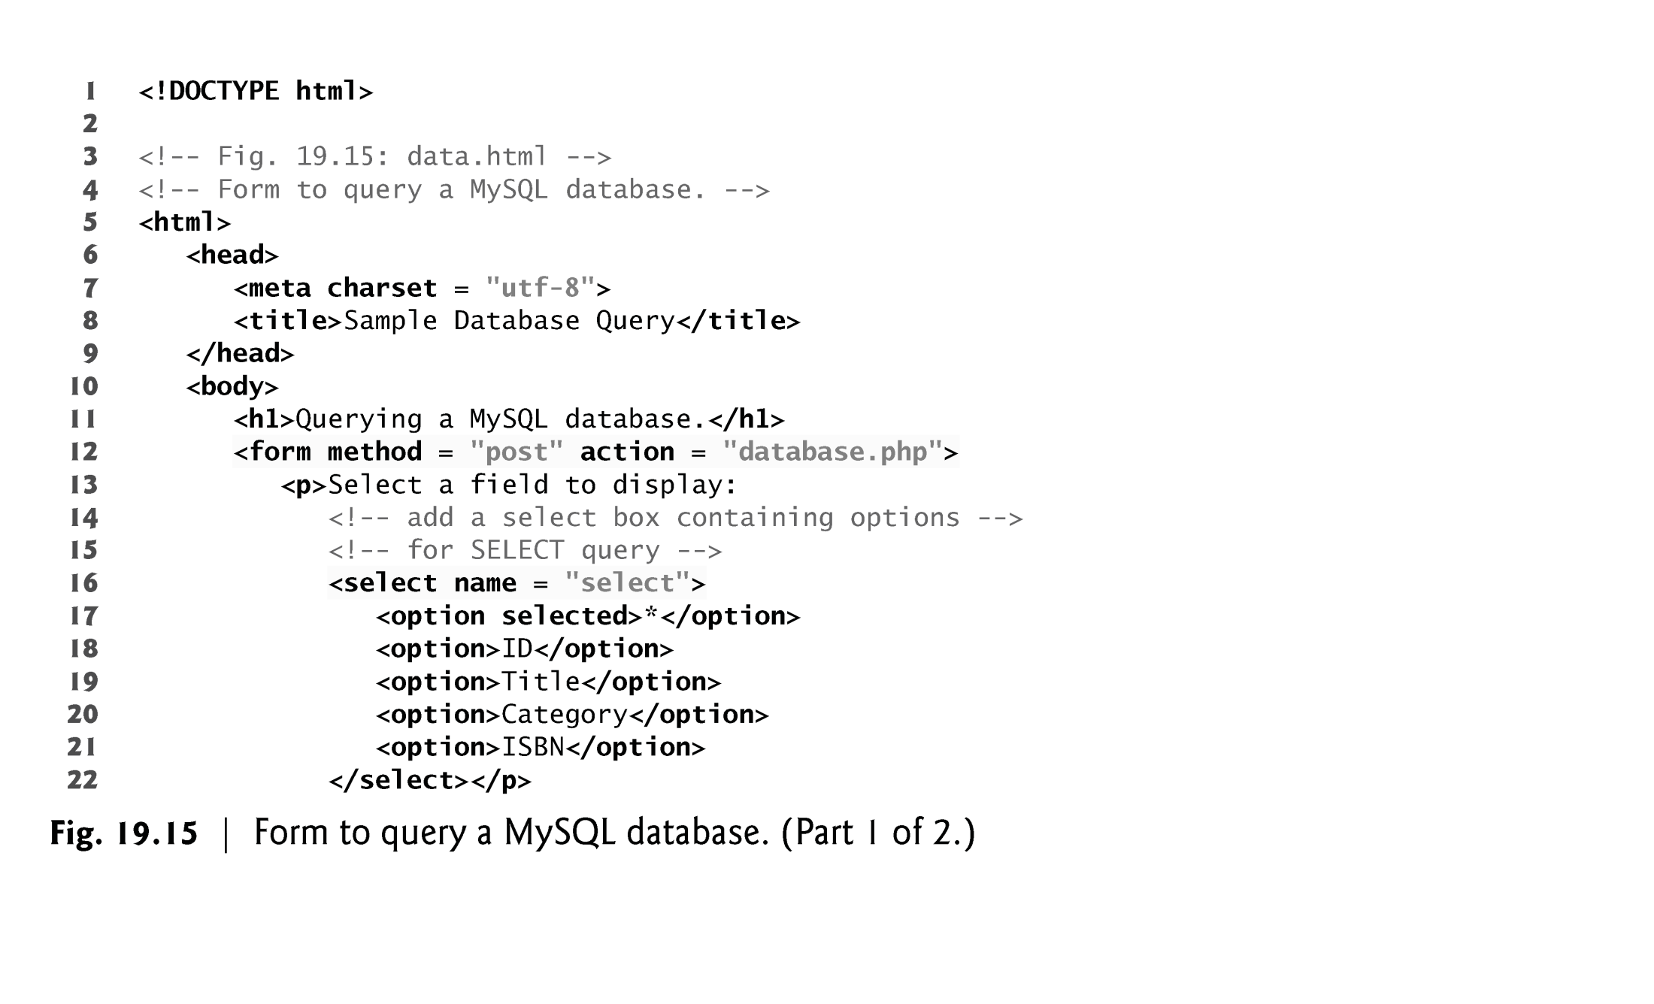

Slide 71
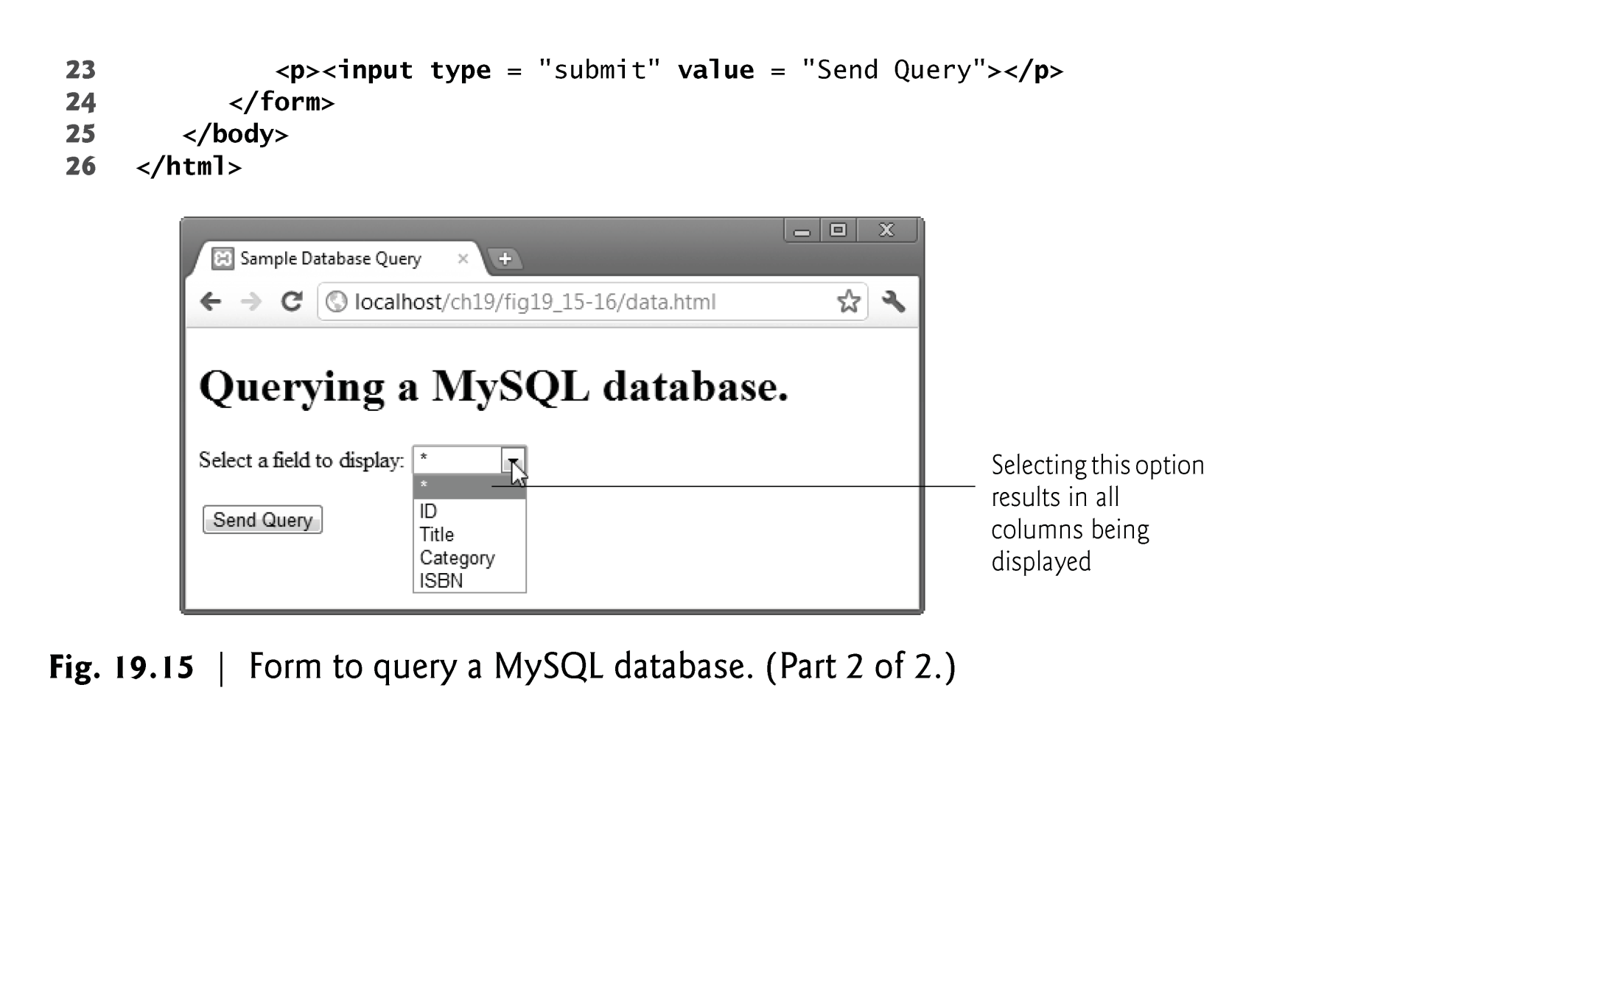

Slide 72
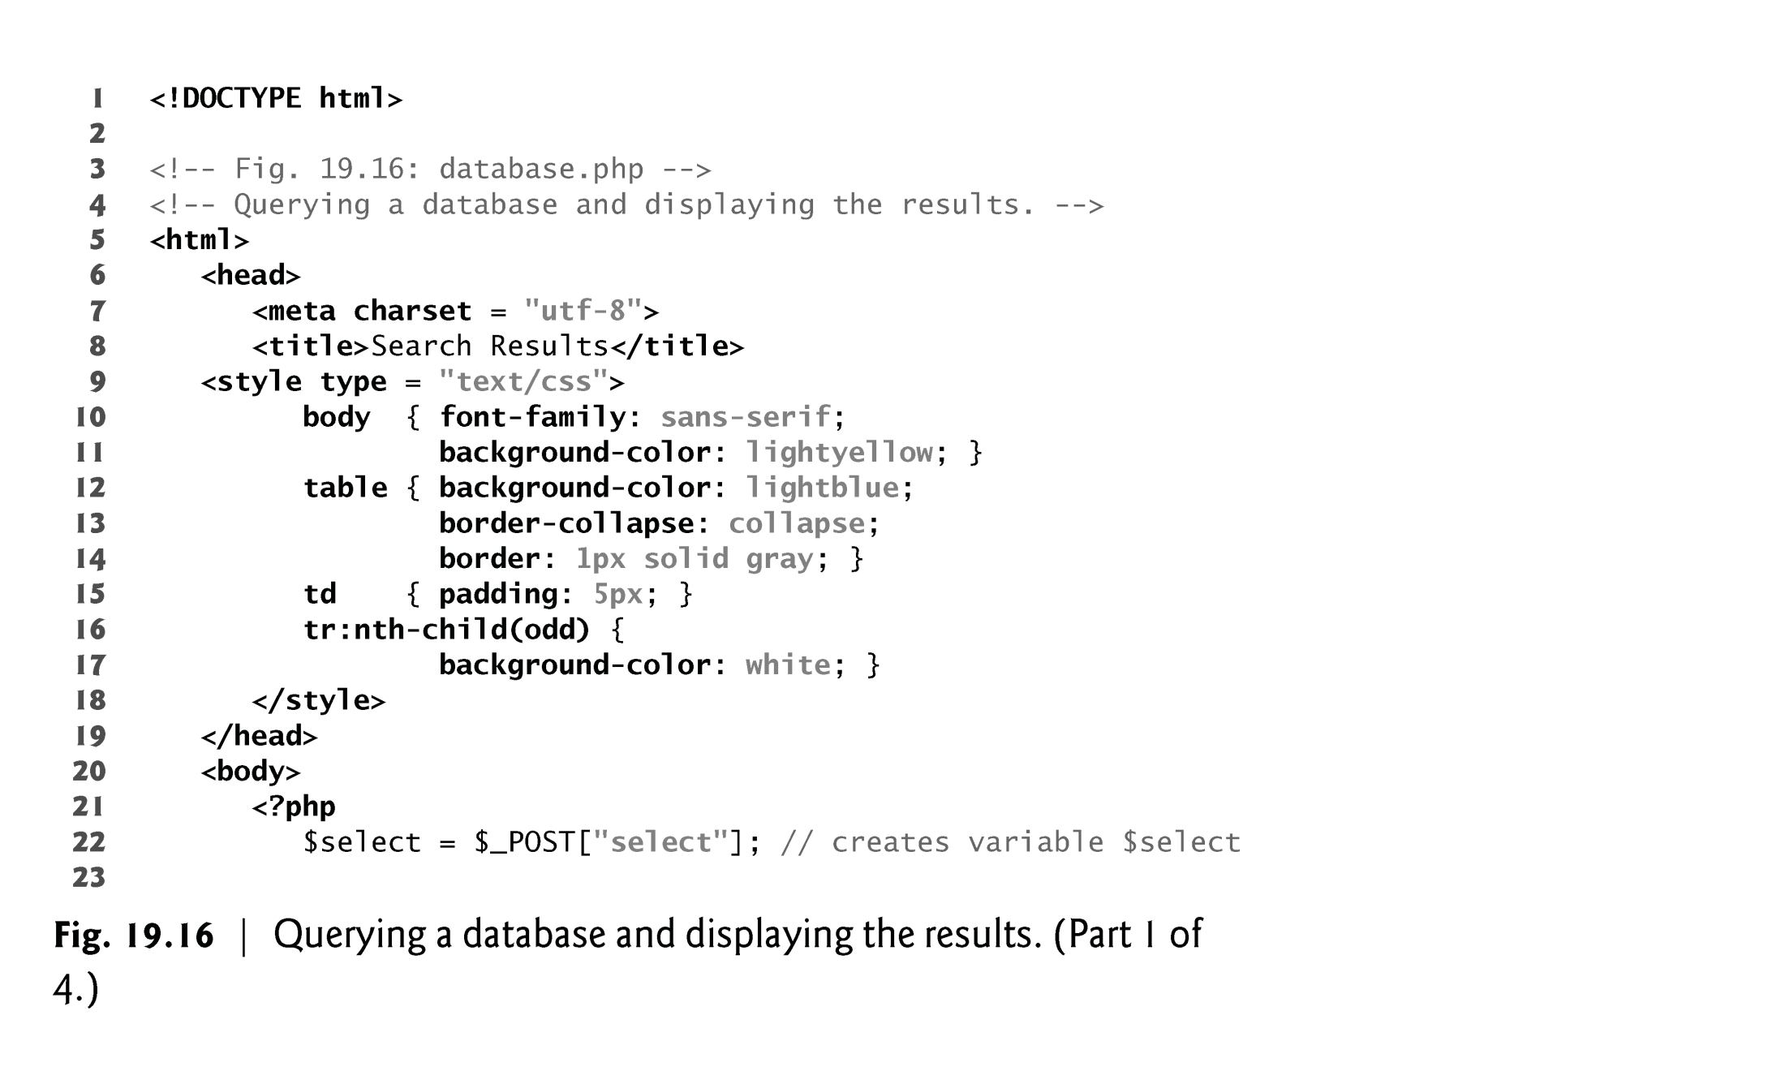

Slide 73


Slide 74


Slide 75


Slide 76
19.10 Using Cookies
A cookie is a piece of information that’s stored by a server in a text file on a client’s computer to maintain information about the client during and between browsing sessions.
A server can access only the cookies that it has placed on the client.
Function setcookie takes the name of the cookie to be set as the first argument, followed by the value to be stored in the cookie.
The optional third argument indicates the expiration date of the cookie.
If no expiration date is specified, the cookie lasts only until the end of the current session—that is, when the user closes the browser. This type of cookie is known as a session cookie, while one with an expiration date is a persistent cookie.

Slide 77
19.10 Using Cookies (Cont.)
If only the name argument is passed to function setcookie, the cookie is deleted from the client’s computer.
Cookies defined in function setcookie are sent to the client at the same time as the information in the HTTP header; therefore, setcookie needs to be called before any other output
PHP creates the superglobal array $_COOKIE, which contains all the cookie values indexed by their names, similar to the values stored in array $_POST when an HTML5 form is posted

Slide 78


Slide 79


Slide 80


Slide 81


Slide 82


Slide 83


Slide 84


Slide 85
19.11 Dynamic Content
The isset function determines whether the $_POST array contains keys representing the various form fields.
The notation$$variable specifies a variable variable, which allows the code to reference variables dynamically.
You can use this expression to obtain the value of the variable whose name is equal to the value of $variable.
The function mysql_real_escape_string inserts a backslash (\) before any special characters in the passed string.

Slide 86


Slide 87


Slide 88


Slide 89


Slide 90


Slide 91


Slide 92


Slide 93


Slide 94


Slide 95


Slide 96


Slide 97


Slide 98


Slide 99


Slide 100


Slide 101


